Slide 1
Contents
v
1 Analysis
1
3
3
5
7
8
1.1 Introduction . . . . . . . . . . . . . . . . . . . . . . . . . . . . . . . . . . . . . . .
1.2 End users . . . . . . . . . . . . . . . . . . . . . . . . . . . . . . . . . . . . . . . .
1.3 Functional requirements . . . . . . . . . . . . . . . . . . . . . . . . . . . . . . . .
1.4 Learning points . . . . . . . . . . . . . . . . . . . . . . . . . . . . . . . . . . . . .
1.5 End of topic test . . . . . . . . . . . . . . . . . . . . . . . . . . . . . . . . . . . . .
2 Design
9
11
23
28
33
40
41
44
51
52
2.1 Introduction . . . . . . . . . . . . . . . . . . . . . . . . . . . . . . . . . . . . . . .
2.2 The relational model . . . . . . . . . . . . . . . . . . . . . . . . . . . . . . . . . .
2.3 Relationships . . . . . . . . . . . . . . . . . . . . . . . . . . . . . . . . . . . . . .
2.4 Entity-occurrence diagrams . . . . . . . . . . . . . . . . . . . . . . . . . . . . . .
2.5 Compound keys . . . . . . . . . . . . . . . . . . . . . . . . . . . . . . . . . . . . .
2.6 Entity relationship diagrams . . . . . . . . . . . . . . . . . . . . . . . . . . . . . .
2.7 Solutions to queries . . . . . . . . . . . . . . . . . . . . . . . . . . . . . . . . . . .
2.8 Learning points . . . . . . . . . . . . . . . . . . . . . . . . . . . . . . . . . . . . .
2.9 End of topic test . . . . . . . . . . . . . . . . . . . . . . . . . . . . . . . . . . . . .
3 Implementation
53
55
59
72
74
76
77
80
82
83
85
86
87
3.1 Application software . . . . . . . . . . . . . . . . . . . . . . . . . . . . . . . . . . .
3.2 Introduction . . . . . . . . . . . . . . . . . . . . . . . . . . . . . . . . . . . . . . .
3.3 Example database . . . . . . . . . . . . . . . . . . . . . . . . . . . . . . . . . . .
3.4 SQL Wildcards . . . . . . . . . . . . . . . . . . . . . . . . . . . . . . . . . . . . .
3.5 Table and column aliases . . . . . . . . . . . . . . . . . . . . . . . . . . . . . . . .
3.6 Using sub-queries . . . . . . . . . . . . . . . . . . . . . . . . . . . . . . . . . . . .
3.7 SQL aggregate functions (MIN, MAX, AVG, SUM, COUNT) . . . . . . . . . . . . . 3.8 Computed values . . . . . . . . . . . . . . . . . . . . . . . . . . . . . . . . . . . . 3.9 GROUP BY . . . . . . . . . . . . . . . . . . . . . . . . . . . . . . . . . . . . . . . 3.10 ORDER BY . . . . . . . . . . . . . . . . . . . . . . . . . . . . . . . . . . . . . . . 3.11 Learning points . . . . . . . . . . . . . . . . . . . . . . . . . . . . . . . . . . . . . 3.12 End of topic test . . . . . . . . . . . . . . . . . . . . . . . . . . . . . . . . . . . . .
4 Testing and evaluation
93
4.1 Testing SQL queries . . . . . . . . . . . . . . . . . . . . . . . . . . . . . . . . . . 95
4.2 Evaluating SQL queries . . . . . . . . . . . . . . . . . . . . . . . . . . . . . . . . . 100
4.3 Learning points . . . . . . . . . . . . . . . . . . . . . . . . . . . . . . . . . . . . . 101
4.4 End of topic test . . . . . . . . . . . . . . . . . . . . . . . . . . . . . . . . . . . . . 102
5 End of unit test
Glossary
105
119

Slide 2
vi
CONTENTS
Answers to questions and activities
122

Slide 3
Analysis
1
Topic 1
Contents
1.1 Introduction . . . . . . . . . . . . . . . . . . . . . . . . . . . . . . . . . . . . . . . . . . . . . .
1.2 End users . . . . . . . . . . . . . . . . . . . . . . . . . . . . . . . . . . . . . . . . . . . . . . .
1.2.1 End user requirements . . . . . . . . . . . . . . . . . . . . . . . . . . . . . . . . . . .
1.3 Functional requirements . . . . . . . . . . . . . . . . . . . . . . . . . . . . . . . . . . . . . . .
3
3
4
5
5
6
6
7
8
1.3.1 Types of functional requirements . . . . . . . . . . . . . . . . . . . . . . . . . . . . . .
1.3.2 Identifying functional requirements . . . . . . . . . . . . . . . . . . . . . . . . . . . . .
1.3.3 Example functional requirements . . . . . . . . . . . . . . . . . . . . . . . . . . . . . .
1.4 Learning points . . . . . . . . . . . . . . . . . . . . . . . . . . . . . . . . . . . . . . . . . . . .
1.5 End of topic test . . . . . . . . . . . . . . . . . . . . . . . . . . . . . . . . . . . . . . . . . . . .

Slide 4
2
TOPIC 1. ANALYSIS
Prerequisites
From your studies at National 5 you should already know about:
•
•
end user requirements;
functional requirements.
Learning objective
By the end of this topic you should be able to:
•
•
•
identify and define the end user from a description of a development project;
explain the term functional requirements;
define a number of functional requirements from the following areas:
◦
◦
◦
◦
interface requirements; business requirements; legal requirements; security requirements.

Slide 5
TOPIC 1. ANALYSIS
3
1.1 Introduction
Data is anything in a form that can be used by a computer. A program is a set of instructions that set out how a computer should perform a particular task or tasks, so data is everything else that isn't a program!
A database is used to store data. A database is an organised store of information so that the data can be easily accessed, managed and updated.
Databases can be found in most aspects of modern life: mobile phones, cars software systems, online shopping, bus ticketing systems and supermarket checkouts all depend on database systems to function.
There are many different types of database management systems (DBMS). These are the tools that allow you to manage the data you store. These tools adopt different methods to structure the data: flat-file, distributed, object-oriented and so on; however, the method used in Higher Computing Science is relational.
Later in this unit, you will use a relational database management system (RDBMS) to execute queries to generate answer tables and manage your data.
1.2 End users
Read the following scenario for a database system.
Bob's Super Sweets is a sweet shop. The owner, Bob, has decided that he needs a database system to manage all the orders that the shop receives via emails and telephone calls. The staff in the shop will be able to enter the details of a customer (or select them if already in the system) and create the order for the customer. Once the order is created, the staff can add the sweets and the weight ordered to the order. The system will then calculate the cost of the order and print out an invoice to send to the customer, with the order, for payment.
Who do you think the end user is? Is it Bob, the customer or the staff in the shop?
When identifying the end user, you have to consider who will actually use the system. The end user is different from the user who supports/maintains the system. The end user, typically, won't have technical knowledge of the system. Also, the end user is usually not the person or company paying for the system (known as the system owner).
In the preceding scenario, the end users are the staff in the shop. They will use the system and the functional requirements of the system will need to be created to meet their needs.
Activity: End user scenarios Go online
Read the following scenarios for database systems and identify the end users.
Q1: Alex Vardy owns a business that trades in used vehicles. He wants to have a database system that will allow the staff in his showroom to enter the details of vehicles that are bought and sold. When a vehicle is bought, the seller will be entered into the database with the details of the vehicle bought by the business. Similarly, when a vehicle is sold, the details of
© HERIOT-WATT UNIVERSITY

Slide 6
4
TOPIC 1. ANALYSIS
the sale and who the buyer is will be entered. The system will create all of the paperwork associated with the trading in vehicles.
Identify the end user(s).
The seller of the vehicle.
Alex Vardy, the owner of the business.
The buyer of a vehicle.
The showroom staff.
...............................................
Q2: Amir Kartal owns a flat and wants a database system as part of his web site for renting out the flat to holiday makers. He will be able to view and edit the bookings made online and print out who has booked the flat and for when. He will use the printouts to make sure that a cleaner is booked to clean the flat after each holidaymaker leaves. Holidaymakers will be able to use the system and book the flat online. They can also print out details of their stay.
Identify the end user(s).
Both Amir and the holidaymakers.
Amir.
The holiday makers.
The cleaners.
...............................................
Q3: A library has decided to set up a database system to allow visitors to search for books and locate them on the shelves within the library. The system is to enhance the service provided by the librarians who work there by allowing visitors to self-serve rather than wait to speak with a librarian.
Identify the end users.
The library owners.
The librarians.
Visitors to the library
Visitors and librarians.
1.2.1 End user requirements
Systems are designed to meet the needs of the end users as well as the requirements of the business/organisation or person commissioning the system. The system should allow end users to carry out the required functions in the most efficient manner.
End users normally have a specific set of skills or experience with technology. This experience will be considered when the interface for the system is designed and developed to ensure that the system is user friendly, reducing the number of user interactions so that the system can be used efficiently and presenting the user with the required commands/options in an accessible way.
These 'interface requirements' are just one element of the functional requirements of the system.

Slide 7
TOPIC 1. ANALYSIS
5
1.3 Functional requirements
All systems have functional and non-functional requirements. Functional requirements specify exactly what the system should do while non-functional requirements describe how the system works.
Example : Functional requirements example
•
'Calculate and display the number of cars sold for a specific range of dates' is a functional requirement - it details something that the system must do.
•
'The system will be reliable and available online 99.9% of the time' is a non-functional requirement - it details how the system should perform but not something that it should do.
When analysing a database problem in Higher Computing Science, you are only required to identify the functional requirements of the solution to be developed.
1.3.1 Types of functional requirements
Functional requirements define specific actions that the solution must perform. There are many possible aspects of the solution that functional requirements may detail. Some of these are detailed as follows.
Interface requirements
What are the user interface requirements for the database system? These can be detailed as functional requirements based on the data entry and output required.
Example : Interface requirements example
The system must provide the main menu options:
•
•
•
manage or add new customers;
manage or create new orders;
customer reports (select from available customers on file).
Business requirements
Business requirements determine the business rules applied within the system.
Example : Business requirements example
The system must calculate VAT on all sales using the current VAT rate. The system will have settings screen which will allow the current VAT rate to be modified and saved.
Legal requirements
All systems are required to meet the relevant laws for the data they hold. This means that rules, such as the General Data Protection Regulation (GDPR), must be applied as required.

Slide 8
6
TOPIC 1. ANALYSIS
Example : Legal requirements example
The system must timestamp all personal data stored and provide a maintenance screen which will allow data to be deleted after a defined retention period. This period can be modified via a settings screen.
Security requirements
All systems should have appropriate security requirements applied to them. These requirements ensure that data is kept securely and that users have the appropriate level of access to the system.
Example : Security requirements example
The system must have three levels of access:
Level 1 will allow read only access to order and customer data.
Level 2 will allow the modification and input of data for all areas of the system.
Level 3 will allow access to all aspects of the system including setup/configuration screens and user management.
1.3.2 Identifying functional requirements
Functional requirements are identified by a systems analyst as part of the analysis of the system. They will be added to the requirements specification or the product backlog depending on whether an iterative development process or an agile one has been adopted.
The process of identifying functional requirements is the same for each approach. The systems analyst will complete the following sequence of activities.
•
End user or system owner request a requirement: The analyst receives the requirement request.
Analyse: the systems analyst examines the requirement; why it is needed and what is required to deliver it. The analyst will have to ensure that the requirement is fully understood before it can be documented. This may include observation of existing operations, reviewing documents produced by existing processes or modelling the requirement to ensure that it is correctly understood.
Use case: a use case is a list of actions or events detailing the interactions, between an end user and the system, to achieve the functional requirement. It is a way to document what must happen.
Incorporate: once the functional requirement is documented, it can be added to the requirements specification or product backlog for implementation.
•
•
•
1.3.3 Example functional requirements
A systems analyst has prepared the following partial functional requirements for Bob's Sweet Shop system. This is written as a number of simple use cases.
•
The system must have an interface to access the following options: manage customers,
© HERIOT-WATT UNIVERSITY

Slide 9
TOPIC 1. ANALYSIS
7
manage orders, manage stock, manage users, modify settings.
•
The manage customers options must allow search, viewing, creation or modification of customer information.
The manage orders option must allow search, viewing, creation or modification of orders.
•
•
•
There must be a print option for each order that will generate an invoice for the order.
When creating or editing an order, it will be possible to select a stock item and enter the weight of that item ordered. The system must calculate the value for each line in an order using the stock item price and the weight.
The system will calculate the total cost of an order and include any additional charges such as VAT and delivery.
•
1.4 Learning points
Summary
You should now know that:
•
•
•
end users can be identified and defined from a description of a development project;
the term functional requirements can be explained;
a number of functional requirements from the following areas can be defined:
◦
◦
◦
◦
interface requirements; business requirements; legal requirements; security requirements.

Slide 10
8
TOPIC 1. ANALYSIS
1.5 End of topic test
End of Topic 1 test
Go online
Q4: Which of the following is not a functional requirement?
The system must allow a password to be set with a minimum of eight characters.
The system must allow a password to be set with at least one upper-case character, one number and one text symbol.
The system will be protected by an authentication system to prevent unauthorised access.
The system must allow a user to login to the system using a username and password.
...............................................
Q5: Who is normally responsible for identifying and documenting the functional requirements?
End user
Programmer
Systems analyst
System owner
...............................................
Q6: How are functional requirements different from non-functional requirements?
Functional and non-functional requirements explain the quality requirements of system. Non-functional requirements state which parts of the system should be measured and the functional requirements detail how each part should be measured.
Functional requirements define what the system must do. Non-functional requirements define how the system should behave.
Functional requirements detail how the modules of code in the system should be linked to each other. Non-functional requirements detail how the documentation will be written.
Functional requirements are defined by the system owner only whereas non-functional
requirements can be suggested by anyone associated with the system.

Slide 11
Design
9
Topic 2
Contents
2.1 Introduction . . . . . . . . . . . . . . . | . . . . . | . . . . | . . . | . . . . . | . . . . . | . . . . | . . . | . . | 11
2.1.1 Entities and attributes . . . . . | . . . . | . . . | . . . | . . . . | . . . . | . . . | . . . | . . | 11
2.1.2 Relationships . . . . . . . . . . | . . . . | . . . | . . . | . . . . | . . . . | . . . | . . . | . . | 11
2.1.3 Primary and foreign keys . . . | . . . . | . . . | . . . | . . . . | . . . . | . . . | . . . | . . | 13
2.1.4 Attribute types and size . . . . | . . . . | . . . | . . . | . . . . | . . . . | . . . | . . . | . . | 15
2.1.5 Validation . . . . . . . . . . . . | . . . . | . . . | . . . | . . . . | . . . . | . . . | . . . | . . | 17
2.1.6 Data dictionary . . . . . . . . . | . . . . | . . . | . . . | . . . . | . . . . | . . . | . . . | . . | 18
2.1.7 Entity relationship diagrams . . | . . . . | . . . | . . . | . . . . | . . . . | . . . | . . . | . . | 20
2.1.8 Design a solution to a query . | . . . . | . . . | . . . | . . . . | . . . . | . . . | . . . | . . | 21
2.2 The relational model . . . . . . . . . . | . . . . | . . . | . . . | . . . . | . . . . | . . . | . . . | . . | 23
2.3 Relationships . . . . . . . . . . . . . . | . . . . | . . . | . . . | . . . . | . . . . | . . . | . . . | . . | 28
2.3.1 One-to-one . . . . . . . . . . . | . . . . | . . . | . . . | . . . . | . . . . | . . . | . . . | . . | 28
2.3.2 Many-to-many . . . . . . . . . | . . . . | . . . | . . . | . . . . | . . . . | . . . | . . . | . . | 30
2.4 Entity-occurrence diagrams . . . . . . | . . . . | . . . | . . . | . . . . | . . . . | . . . | . . . | . . | 33
2.5 Compound keys . . . . . . . . . . . . . | . . . . | . . . | . . . | . . . . | . . . . | . . . | . . . | . . | 40
2.6 Entity relationship diagrams . . . . . . | . . . . | . . . | . . . | . . . . | . . . . | . . . | . . . | . . | 41
2.7 Solutions to queries . . . . . . . . . . . | . . . . | . . . | . . . | . . . . | . . . . | . . . | . . . | . . | 44
2.8 Learning points . . . . . . . . . . . . . | . . . . | . . . | . . . | . . . . | . . . . | . . . | . . . | . . | 51
2.9 End of topic test . . . . . . . . . . . . . | . . . . | . . . . | . . . | . . . . | . . . . | . . . | . . . | . . | 52
.
.
.
.
.
.
.
.
.
.
.
.
.
.
.
.
.
.
.
.
.
.
.
.
.
.
.
.
.
.
.
.
.
.
.
.
.
.
.
.
.
.
.
.
.
.
.
.
.
.
.
.
.
.
.
.
.
.
.
.
.
.
.
.
.
.
.
.
.
.
.
.
.
.
.
.
.
.
.
.
.
.
.
.
.
.
.
.
.

Slide 12
10 TOPIC 2. DESIGN
Prerequisites
From your studies at National 5 you should already know how to:
•
use simple entity relationship diagrams, making use of a one-to-many relationship between entities and showing their attributes;
construct a data dictionary and know its purpose;
•
•
identify attribute types including text, number, date, time and Boolean and attribute sizes where required;
•
•
specify validation rules for data;
design a query based on two tables, fields, search criteria and sort order.
Learning objective
By the end of this topic you should be able to:
•
•
create and describe entity-relationship diagrams using three or more entities;
exemplify relationships and their cardinality as one-to-one, one-to-many or many-to- many;
•
use entity-occurrence diagrams to identify and present the relationship between two entities;
•
•
describe, and explain through examples, a compound key;
describe, and explain through examples, a data dictionary with three or more entities including attribute names, types, size and validation;
design, create and explain a design of solution to a query making use of tables, queries, fields, search criteria, sort order, calculations and grouping.
•
© HERIOT-WATT UNIVERSITY

Slide 13
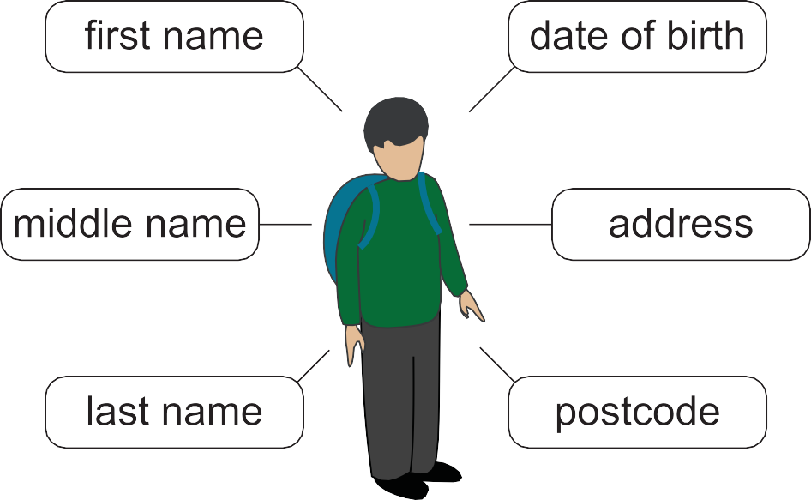


TOPIC 2. DESIGN
11
  Introduction
In Higher Computing Science we use the relational database model. The model details how data is to be organised, how it can be accessed and how it can be manipulated. This topic deals with how solutions to database problems are designed. This introduction is a recap of what you will have covered as part of the National 5 course.
    Entities and attributes
During the design of a database we refer to entities and attributes.
An entity is something that exists - it is something that we want to store information about. It could be a physical thing (such as a book or a person) or it could be something abstract (such as a reservation at a restaurant or a payment for rent on a home).
A collection of entities (all the students in a school, for example) is called an entity set.
Attributes are the information that we hold about an entity. For example, a student in school is an entity and the attributes that may be stored for a student are: first name, middle name, last name, date of birth, address, postcode and so on.
Figure 2.1: Student entity with attributes
2.1.2 Relationships
Relationships show how two entities are related to each other. You should be familiar with the relationship type one-to-many.
For example, one doctor will have many registered patients, but each patient will have only one registered doctor.
© HERIOT-WATT UNIVERSITY

Slide 14
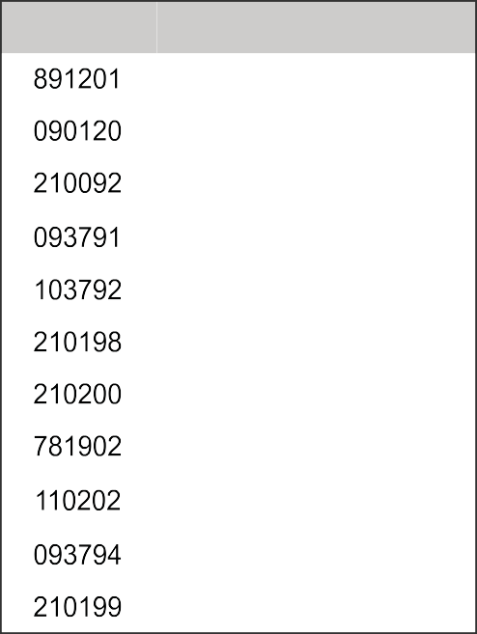
12 TOPIC 2. DESIGN
Table 2.1: One-to-many relationship
This is a one-to-many relationship. An entity on one side can be associated with multiple entities on the other side BUT the entities on the other side are only associated with one entity opposite them, i.e Dr James Brown has two registered patients: Miss Louise Flower and Mr Nick Spencer AND Miss Louise Flower is only registered with ONE doctor, Dr James Brown.
A further example would be accounts on a social media platform and posts made. Each account can create one or more posts but each post is created by only one account.
Table 2.2: Another one-to-many relationship
There are other types of relationship which we will cover later in this topic.
© HERIOT-WATT UNIVERSITY

Slide 15
TOPIC 2. DESIGN
13
2.1.3 Primary and foreign keys
When an entity follows the rules for the relational model, it should have a primary key. This is a value which is unique for the entity. In the example of social media posts which follows, each user has a unique UserID and each post has a unique PostID.
UserID is the primary key of the User entity. PostId is the primary key of the Post entity.
Table 2.3: One-to-many relationship with primary and foreign keys
When listing the attributes of an entity we use an underline to indicate the primary key.
A foreign key is a primary key value from one entity included in a related entity. The purpose of the foreign key is to establish the relationship between the two entities. A foreign key is typically shown in notation using an asterisk *.
In the preceding example, the primary key of User, UserID has a related foreign key in the Post entity. The two entities are now linked by primary/foreign key values that they have in common.
The posts for 'WhoRYou' can be found by using the unique value of UserID for this user, 72620, and looking for the same value in the foreign key within the posts table. In the example above, this shows that there are three posts by this user.
© HERIOT-WATT UNIVERSITY

Slide 16

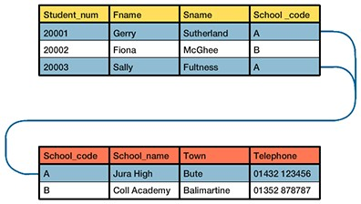
14 TOPIC 2. DESIGN
Activity: Primary and foreign keys
Go online
How a foreign key is used to relate data in separate entities:
Two separate entities:
Student num | Fname | Sname
20001 | Gerry | Sutherland
20002 | Fiona | McGhee
20003 | Sally | Fultness
School num | Town | Telephone
Jura High | Bute | 01432 123456
Coll Academy | Ballimartine | 01352 878787
'School-code keys are added to each entity:
Student num | Fname | Sname | School code
20001 | Gerry | Sutherland | A
20002 | Fiona | McGhee | B
20003 | Sally | Fultness | A
School code | School num | Town | Telephone
A | Jura High | Bute | 01432 123456
B | Coll Academy | Ballimartine | 01352 878787
Key A relationship:
© HERIOT-WATT UNIVERSITY

Slide 17
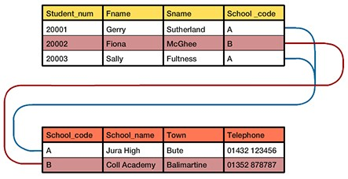
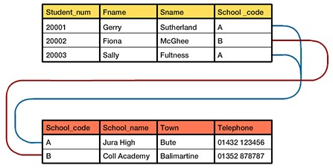
TOPIC 2. DESIGN
15
Key B relationship:
School-code is the foreign key in the upper entity and is used in the lower entity as a primary key providing a link between the two entities.
2.1.4 Attribute types and size
Attributes hold specific types of data. For the National 5 and Higher Computing Science courses these types are defined as follows:
•
text: Any data that is represented using a string of text. For example, the attribute lastname would normally be stored as text;
number: Any data that is represented using number values. These can be integer or decimal values. Floating point representation may also be used to store very large or very small numbers;
•
•
date: Any data that is of date format. For example: date of birth: '24/09/2003' is a date format. It is worth noting that many SQL software solutions display dates in the format YYYY/MM/DD. In this case, the date above would be '2003/09/24';
© HERIOT-WATT UNIVERSITY

Slide 18
16 TOPIC 2. DESIGN
•
time: Data about the time is stored in a time type. This can be more than the time of day e.g. 16:00:00, it can also hold an amount of time (duration) e.g. 561:01:02 (this is 561 hours, 1 minute and 2 seconds);
Boolean: Attributes which are Boolean are either True or False.
•
Activity: Attribute types and size
Go online
Q1: Select the data types that you would use to store the following:
Attribute | Example | Data type
Surname | Toner
First name | Geraldo
Postcode | TD7 0EG
SQA candidate number | 2311447853
Enrollment fee paid | £27.50
All documents received | True
Enrolment date | 23/03/14
Course begins at | 19:30
Qualification credit value | 24
Data types:
•
•
•
•
•
Text Number Date Time Boolean
Size of attributes
Where attributes are of the text type, it is normal to specify their size as the maximum possible characters for these attributes. This can be done in a data dictionary and shown as the data type followed by a number of characters, e.g. text (16). This would define the attribute as being text and a maximum of 16 characters.
© HERIOT-WATT UNIVERSITY

Slide 19
TOPIC 2. DESIGN
17
    Validation
Validation is used to check that the data entered for an attribute is what is expected. There are four types of validation that can be applied to an attribute.
      Presence check: this validation rule ensures that there is a value allocated in the attribute. When an attribute has no value assigned to it, it will have a value of Null. Null is a technical term meaning no value is available. It is not the same as zero or empty text "" (a string with no characters in it). Often the word "Required" is entered in a data dictionary to show that a presence check is needed.
      Restricted choice: validation of this type limits the values for an attribute to a selection of predefined options. For example: Jackets are available in sizes S, M, L, XL, XXL. These are the only allowed values for the attribute. Validation rules for this can be written as "Limit to: S, M, L, XL, XXL" or may be written as "Look up: S, M, X, XL, XXL" in a data dictionary.
      Field length: Attributes of type text can be limited so that they must be a given number of characters. There could be a minimum number of acceptable characters (e.g. your PIN must be at least 4 characters), a maximum number of characters (e.g. the maximum length of your message is 280 characters) or a mix of both (e.g. you username must be more than 8 and less than 16 characters long).
      Range: the value of an attribute can be limited to values between a maximum and a minimum, giving a range of possible values. For example, an attribute could be validated to ensure that it was between 0 and 10 or between 0.01 and 0.99 or between -25 and 25.
This isn't limited to just attributes of the type number but can also be applied to attributes of type text. For example, limiting values from >= A and <= E would allow the values A, B, C, D and E to be used.
Activity: Validation Go online
Choose the correct type of presence check for the attributes in each of the following questions.
Q2: UK children's shoes are available in sizes 1 to 11. Assume that integers are required for data input.
Attribute: Shoesizes Example: 10 Validation: ?
Presence check
Restricted Choice
Field Length
Range
...............................................
© HERIOT-WATT UNIVERSITY

Slide 20
18 TOPIC 2. DESIGN
Q3: A password for a web site must be 10 or more characters long. Attribute: Password
Example: "Secretpassword10" Validation: ?
Presence check
Restricted Choice
Field Length
Range
...............................................
Q4: Users must accept the terms and conditions. Attribute: TermsCheckBox
Example: ⊗
Validation: ?
Presence check
Restricted Choice
Field Length
Range
...............................................
Q5: A voting response allows users to return "Yes","No" or "Don't Know". Attribute: Vote
Example: "Yes" Validation: ?
Presence check
Restricted Choice
Field Length
Range
2.1.6 Data dictionary
A data dictionary is data about data. It is the detailed design for one or more entities in a system. A data dictionary is laid out as a table containing the definition of each attribute (and entity). Consider this data dictionary for a system for booking a swimming pool.
© HERIOT-WATT UNIVERSITY

Slide 21
TOPIC 2. DESIGN
19
Table: Customer
CustomerID | CustomerName | CustomerAddress | CustomerPhone
1001 | Raymond Boyce | 13 Western St, Dunfermline, KY11 7TQ | 01929 928311
1002 | Edgar Codd | 17 Queen St, Dunfermline, KY12 3EA | 01929 827191
1003 | Larry Ellison | The Lake House, Carnegie, KY12 8YH | 01929 883919
1004 | Safra Catz | 92a Viewfield, Dunfermline, KY11 9UA | 01929 667818
Table: Booking
BookingID | BookingTime | BookingDate | CustomerID
2910 | 11:00 | 27/07/2018 | 1001
2912 | 12:30 | 27/07/2018 | 1002
2913 | 14:00 | 28/07/2018 | 1003
2918 | 12:00 | 28/07/2018 | 1004
A data dictionary for this system:
Entity Name: Customer
Attribute | Primary/Foreign Key | Data | Validation
CustomerID | Primary Key | Number
CustomerName |  | Text(70)
CustomerAddress |  | Text(475)
CustomerPhone |  | Text(22)
Entity Name: Booking
Attribute | Primary/Foreign Key | Data | Validation
BookingID | Primary Key | Number
BookingTime |  | Time
BookingDate |  | Date
CustomerID | Foreign Key | Number | Lookup from Customer
© HERIOT-WATT UNIVERSITY

Slide 22

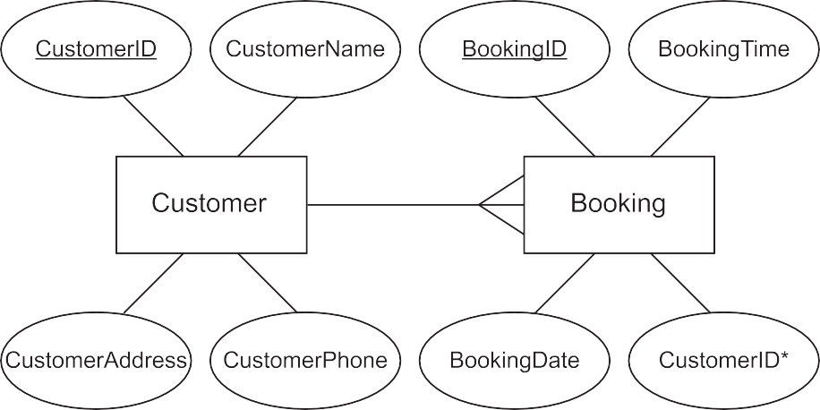
20 TOPIC 2. DESIGN
    Entity relationship diagrams
The Entity relationship diagram (ERD) illustrates the structure of any database. It provides a method of illustrating entity sets, relationships and attributes. Entity relationship diagrams make use of the following symbols.
•
A rectangle is used to represent each entity set. Remember, an entity set is a collection of entities. The name of the entity set is entered inside the rectangle to identify it. The name must never be a plural, it must always be a singular e.g. person rather than people.
The relationship between the two entity sets. Relationships illustrate how two entities sets share information. A short phrase is written above the line to describe the relationship. The 'crows feet' show the many side of the relationship.
•
Attributes can be added to the ERD as ovals. The name of the attribute is entered inside the oval.
•
If an attribute is the primary key or part of the primary key for the entities in the entity set then its name is underlined inside the oval.
A simple entity relationship diagram for the swimming pool system shown in the previous data dictionary would be:
With the attributes added it would be:
© HERIOT-WATT UNIVERSITY

Slide 23
TOPIC 2. DESIGN
21
2.1.8 Design a solution to a query
Previously you will have designed solutions to simple queries that access one or two tables. The design of a query requires that you make use of:
•
•
•
•
multiple tables;
fields;
search criteria;
sort order.
A query, when it runs, produces an answer table. The answer table is a collection of the data that matches the requirements of the query.
Multiple tables
An entity set is implemented as a table in a database. Each row of the table represents an instance of an entity.
Example
Table: artist
artist id | firstname | lastname
0001 | gary | barlow
0002 | robbie | williams
0003 | cheryl | cole
0004 | dolly | parton
Table: album
album id | title | artist id*
01 | Since I saw you last | 0001
02 | Open road | 0001
03 | Escapology | 0002
04 | Better day | 0004
05 | Swing when you are winning | 0002
© HERIOT-WATT UNIVERSITY

Slide 24
22 TOPIC 2. DESIGN
Fields
The attributes of an entity are implemented as fields in the database. These are the columns of the tables. The table artist in the example has the fields artist-id, firstname and lastname and the table album has the fields album-id, title and artist-id.
Search criteria
When constructing a query, we often need to select specific results based on the values of fields. Search criteria are applied to select the values that are required for the solution.
For example: firstname="gary", title="Better day", title = "*you*" (where * is a wildcard which means any value).
Sort order
The answer table produced by a query can be sorted based on values held in the columns. For example, the album table is sorted on album-id, ascending.
Answer tables can sorted on one, two or more fields in ascending or descending orders. For example, this answer table is sorted on:
year descending, comic-id ascending, hero-name ascending
Year | comic id | hero name
2017 | 6171 | Aqua matrix
2017 | 6171 | Super mole
2017 | 8109 | Jules Volt
2017 | 8109 | Rocket
2016 | 5261 | Bear Meteor
2016 | 5261 | No Capes
2016 | 5278 | X-field
2015 | 9188 | Superflea
2015 | 9188 | Transfirma
Representing query design
To represent the design of a query the following layout can be used. Each element of the query is presented as follows.
Tables
Fields
Search criteria
Sort order
© HERIOT-WATT UNIVERSITY

Slide 25
TOPIC 2. DESIGN
23
A database contains the following tables (as you saw earlier). Table: Customer
CustomerID | CustomerName | CustomerAddress | CustomerPhone
1001 | Raymond Boyce | 13 Western St, Dunfermline, KY11 7TQ | 01929 928311
1002 | Edgar Codd | 17 Queen St, Dunfermline, KY12 3EA | 01929 827191
1003 | Larry Ellison | The Lake House, Carnegie, KY12 8YH | 01929 883919
1004 | Safra Catz | 92a Viewfield, Dunfermline, KY11 9UA | 01929 667818
Table: Booking
BookingID | BookingTime | BookingDate | CustomerID
2910 | 11:00 | 27/07/2018 | 1001
2912 | 12:30 | 27/07/2018 | 1002
2913 | 14:00 | 28/07/2018 | 1002
2918 | 12:00 | 28/07/2018 | 1004
A query is required to display the name, booking time, booking date and phone number for all the people from post codes starting with 'KY11' who have a booking. The results (the answer table) should be sorted on Booking Date and Booking Time, both ascending.
The query design would be:
Tables | Customer, Booking
Fields | CustomerName, BookingTime, BookingDate, CustomerPhone
Search criteria | CustomerAddress = "*KY11*", Customer.CustomerID = Booking.CustomerID
Sort order | BookingDate ASC, BookingTime ASC
2.2 The relational model
A relational database is a database which contains more than one table. The tables are linked together by using primary and foreign keys.
Advantages of a relational database
Relational databases were developed to avoid unnecessary duplication of data in the database.
© HERIOT-WATT UNIVERSITY

Slide 26
24 TOPIC 2. DESIGN
Let's look at a Flat-file database to see what we mean by unnecessary duplication: Library loans:
Borrower No | Borrower Name | Borrower Address | Borrower Phone | Book No | Title | Author | Loaned Out | Due Back
1001 | Edgar Codd | 12 High Street, Scholar | 01234 985443 | F1301 | Wuthering Heights | Bronte, C | 12 Jan | 11 Feb
1002 | Raymond Boyce | 6 Castle View, Scholar | 01234 983458 | F1301 | Wuthering Heights | Bronte, C | 12 Feb | 11 Mar
1001 | Edgar Codd | 12 High Street, Scholar | 01234 985443 | F1109 | To Kill a Mocking- bird | Lee, H | 14 Jan | 13 Feb
As you can see, all the fields about the borrower (Borrower No, Name, Address...) have to be inserted for each book the lender loans, and the same is also true of the book details each time it is loaned out. This is unnecessary duplication, and can cause problems:
•
it is time consuming for the database operator (this is a simplified example - a real borrower may need many fields);
•
•
mistakes can be made (can you see any in the table above?);
what if the borrower leaves the library? The General Data Protection Regulation would mean the library would have to remove the borrower's details from the database - how would this work if they have loaned hundreds of books!
what if you want to add book details to the library database - ideally you would need someone to borrow the book, so the record is complete.
•
Let's take a look at a relational version of this database now:
Borrower:
BorrowerNo | BorrowerName | BorrowerAddress | BorrowerPhone
1001 | Edgar Codd | 12 High Street, Scholarville | 01234 985443
1002 | Raymond Boyce | 6 Castle View, Scholarville | 01234 983458
Book:
BookNo | Title | Author
F1301 | Wuthering Heights | Bronte, C
F1109 | To Kill a Mockingbird | Lee, H
© HERIOT-WATT UNIVERSITY

Slide 27
TOPIC 2. DESIGN
25
Loan:
LoanID | BorrowerNo* | BookNo* | LoanedOut | LoanedOut
10292 | 1001 | F1301 | 12 Jan | 11 Feb
10293 | 1002 | F1301 | 12 Feb | 11 Mar
10294 | 1001 | F1109 | 14 Jan | 13 Feb
As you can see now:
•
•
•
all the information about books is stored only once;
all the information about borrowers is stored only once;
all the information about loans is stored only once.
Each loan is linked (related) by the BookNo and BorrowerNo to the record in each table. This solves all of the above problems (bar the mistake problem; however, at least if an operator enters the wrong value for some book or borrower data, it only needs to be changed once and all loan records will be correct).
In the relational model, tables of data are valid as long as they meet the following rules.
Every table in a database must have a unique name.
Every column in a table must have a unique name within that table.
All entries in a column must be of the same kind.
The ordering of columns in a table is not significant.
Each row in a table must be unique. Duplicate rows are not allowed in a table.
The order of the rows is not important in the table.
Each cell in the table (the intersection of a column and a row) must contain only one value. Multiple entries are not allowed in a cell.
Columns and column characteristics
Each column in a table must have a unique name. Two or more tables within the same database may have columns with the same name.
When the same column name appears in more than one table and tables that contain that column are referred to at the same time then we use the table name to distinguish between the two columns. For example, we would refer to the BorrowerNo column in the above two relations as:
Borrower.BorrowerNo and Loan.BorrowerNo
Each column in a table must draw the data that it contains from the same domain. This means that each column must contain data of the same nature. This is easier to understand if we look at this incorrect snapshot of part of the borrower table from the library example.
© HERIOT-WATT UNIVERSITY

Slide 28
26 TOPIC 2. DESIGN
Table 2.4: Column from student table
BorrowName
Sally Burton
John Low
0821 928192
Sandy Ogston
Brian Wilson
Sally Smith
In this example, the column is intended to store the borrower name. However, the data entered for the third borrower is a phone number. Clearly, the data in this column is not entirely from same domain (i.e. not all borrower names) and, therefore, is invalid.
Rows and row characteristics
Each row in a table must be unique. This means that the combination of values in the columns of one row cannot be found elsewhere in the table. Again, this is much easier to understand if we look at an example from the library database:
Table 2.5: Duplicate rows from the Borrower table
Borrower No | Borrower Name | Borrower Address | Borrower Phone
1001 | Edgar Codd | 12 High Street, Scholar | 01234 985443
1002 | Raymond Boyce | 6 Castle View, Scholar | 01234 983458
1003 | Safra Catz | 92a Viewfield, Scholar | 01929 667818
1001 | Edgar Codd | 12 High Street, Scholar | 01234 985443
Here we see four rows from an incorrect snapshot of the Borrower table. Each cell (row/column intersection) of the first and fourth rows contains the same data. In fact, the fourth row is an exact duplicate of the first. The fourth row is not required because the data it stores is already held in the first row. If the fourth row was held in the table then the table would be invalid because each row would not then be unique. Now look at this other example:
Table 2.6: Correct rows from the Borrower table
Borrower No | Borrower Name | Borrower Address | Borrower Phone
1001 | Edgar Codd | 12 High Street, Scholar | 01234 985443
1002 | Raymond Boyce | 6 Castle View, Scholar | 01234 983458
1003 | Safra Catz | 92a Viewfield, Scholar | 01929 667818
1004 | Edgar Codd | 12 High Street, Scholar | 01234 985443
© HERIOT-WATT UNIVERSITY

Slide 29
TOPIC 2. DESIGN
27
Your first reaction when you look at this sample of rows is that it is invalid. However, the values for BorrowerNo for rows one and four are different and, therefore, each row is unique. This example tells us there are two different people called 'Edgar Codd' at the same address with the same phone number!
Cells
Each cell in a table must contain only one piece of data. A cell is the point where a column and a row meet.
Figure 2.2: Example of a cell in a table
The value of the cell in Figure 2.6 is 'Susan'. Every cell in the above table contains only one value. Multi-value cells are not allowed so the following table would be invalid.
Table 2.7: A table with invalid rows
Borrower No | Borrower Name | Borrower Address | Borrower Phone | Book No | Title | Author | Loaned Out | Due Back
1001 | Edgar Codd | 12 High Street, Scholar | 01234 985443 | F1301 F1109 | Wuthering Heights To Kill a Mocking- bird | Bronte, C Lee, H | 12 Jan 14 Jan | 11 Feb 13 Feb
1002 | Raymond Boyce | 6 Castle View, Scholar | 01234 983458 | F1301 F1109 | Wuthering Heights To Kill a Mocking- bird | Bronte, C Lee, H | 12 Feb 14 Feb | 11 Mar 14 Mar
The preceding example has multiple values in cells in the BookNo, Title, Author, LoanedOut and DueBack columns. These multi-valued cells are not permitted in a relational database. Only single- valued cells are allowed.
Quiz: Introduction Go online
Q6: Describe two features of a column in a relational database.
...............................................
© HERIOT-WATT UNIVERSITY

Slide 30
28 TOPIC 2. DESIGN
Q7: Explain the difference between a flat file database and a relational database.
...............................................
Q8: Are multi-valued cells allowed in a relational database?
Yes
No
  Relationships
In addition to the one-to-many relationship you are familiar with from National 5, there are two other types of relationship which can exist between entities.
The type of a relationship is called the cardinality of the relationship. In an examination, you may be asked to identify the cardinality of a relationship.
There are three cardinalities.
    One-to-many
    One-to-one
    Many-to-many
You should already be able to describe and use one-to-many.
2.3.1 One-to-one
A one-to-one relationship specifies that for one entity there is only one other corresponding entity.
Example Students in Lochussie High School are each allocated a locker to use during their time at school. This locker is not shared and can only be used by the pupil to whom it has been allocated.
StudentID | StudentName | RegisterClass |  | LockerNum | LockerType
43781 | Jennifer Brown | 4A |  | 232C | Vanguard
57842 | Amir Anderson | 3E |  | 234C | Guardian
23423 | Scott Andrew | 6F |  | 728D | Athletic
23426 | Wendy Alexander | 2F |  | 483B | Vanguard
One-to-one relationship
© HERIOT-WATT UNIVERSITY

Slide 31
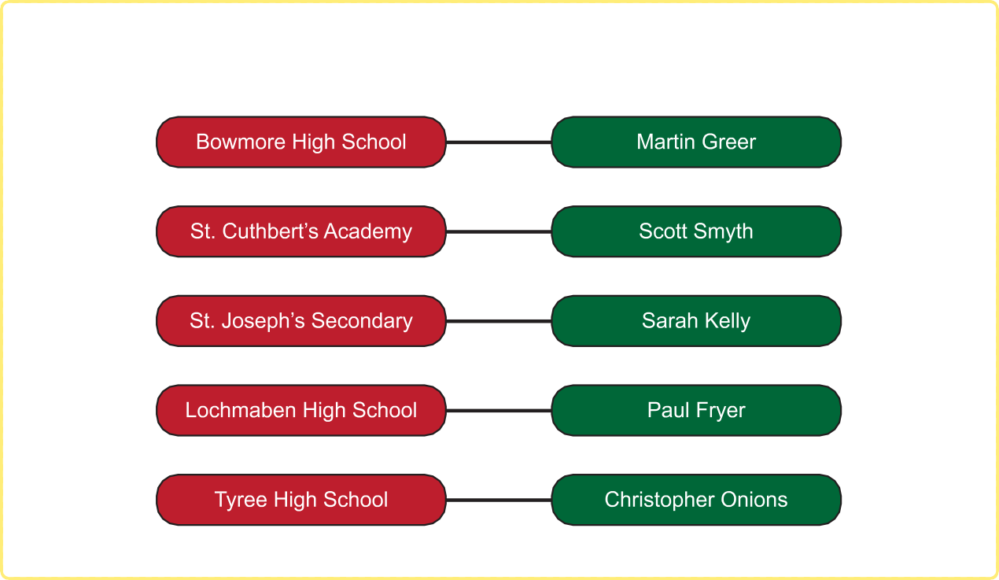

TOPIC 2. DESIGN
29
For every student there is one locker and for every locker there is one student. It is also acceptable for a student to not have a locker or for a locker to not be allocated.
In an ERD (entity relationship diagram) this is represented as 1:1.
Figure 2.3: One-to-one ERD
Example Each local secondary school has a head teacher, and each head teacher is head teacher at only one school.
One-to-one relationship
In an ERD (entity relationship diagram) this is represented as 1:1.
Figure 2.4: One-to-one relationship
© HERIOT-WATT UNIVERSITY

Slide 32
30 TOPIC 2. DESIGN
2.3.2 Many-to-many
With many-to-many relationships, either side of the relationship can have none, one or many links.
Example Teachers and students in a school are being recorded using an ERD. A teacher can have many students and a student can have many teachers.
An example of a many-to-many relationship
In an ERD (entity relationship diagram) this is represented as M:N.
Figure 2.5: Many-to-many relationship
© HERIOT-WATT UNIVERSITY

Slide 33





TOPIC 2. DESIGN
31
Activity: Many-to-many (1)
Go online
Here a student sits as many as four exams and each exam is sat by as many as nine students. This can be represented in an ERD as a many-to-many relationship.
Many-to-many relationship
© HERIOT-WATT UNIVERSITY

Slide 34

32 TOPIC 2. DESIGN
Activity: Many-to-many (2) Go online
Q9: Select the relationship between each pair of entities from the options provided.
Entity 1 | Entity 2 | Relationship
School | Head Teacher
Teacher | Course
Classroom | Desk
School | Swimming pool
Pupil | Exam
Options: 1-to-1, 1-to-many, many-to-many.
Quiz: Relationships
Go online
Q10: Explain each of these terms.
Entity
Attribute
Relationship
...............................................
Q11: An online ordering system needs to be designed. It will always have at least one customer and each customer may place multiple orders.
Complete the following ERD to describe such a system by selecting the correct relationship symbol between the entities:
© HERIOT-WATT UNIVERSITY

Slide 35
TOPIC 2. DESIGN
33
2.4 Entity-occurrence diagrams
The first step in constructing a model of any system is to examine the entities and relationships. It is relatively easy to identify the entities involved. Each collection of entities is an entity set.
Each of these entity sets will deal with a specific collection of entities: Borrower, Loan, Book, etc.
All entities in an entity set must have the same attributes and each attribute must have a specific domain. Remember, a domain is the set of permitted values for an attribute and therefore defines what the attribute can and cannot store.
Entity occurrence diagrams are achieved by looking at specific relationship occurrences and linking entity occurrences with lines, one line for each occurrence of the relationship.
Creating an E/R occurrence diagram
Entity-Relationship occurrence modelling is a technique which helps to identify the relationship between two entities. In order to successfully use E/R occurrence modelling, a systems analyst must have a full understanding of the system being analysed, and sample data with which to work.
Identify the entities and their primary keys
The first process is to identify a primary key for each entity. In this case, Borrower has a primary key of BorrowerNo, Loan has a primary key of LoanID.
Create a list of primary key values
With the primary keys for each entity decided the next step is to write down the primary key values so that the E/R occurrence diagram can be constructed.
Table 2.8: Primary key values
BorrowerID | LoanID
1001 | 10292
1002 | 10293
 | 10294
In the preceding table, each primary value from the two sample Borrowers from the Borrower entity and the Loan table have been listed.
Link Primary Keys
Once the list of the primary key values is completed lines are drawn to illustrate how the values link together. This line is one occurrence of the relationship between the two entities. Look at the first record for borrower '1001' in the Borrower data in the sample, and look at the value for LoanID. On the E/R occurrence diagram we draw a line between the BorrowerID value and the LoanID value.
Table 2.9: Starting to create an entity occurrence diagram
BorrowerID | LoanID
1001 | 10292
1002 | 10293
 | 10294
This line indicates one 'link' between the Borrower entity set and the Loan entity set. To complete
© HERIOT-WATT UNIVERSITY

Slide 36
34 TOPIC 2. DESIGN
the E/R occurrence diagram we add 'links' for all the remaining records from the sample data. To put it another way, we draw a line to represent each instance of the relationship between the two entities sets.
Table 2.10: Entity occurrence diagram
BorrowerID | LoanID
1001 | 10292
1002 | 10293
 | 10294
What does this tell us about the relationship between Borrower and Loan? Each Borrower has one or more Loans linked to it and each Loan has one Borrower linked to it.
One Borrower has many Loans and one Loan has one Borrower. The relationship between Borrower and Loan is one-to-many. The pattern of the lines in the entity-relationship occurrence diagram can be used to identify the nature of the relationship between two entities sets.
When an E/R occurrence diagram is created, one of three patterns will appear in the lines. There is one pattern for each of the three relationship cardinalities: one-to-one, one-to-many and many- to-many. Each of the following examples demonstrates the pattern that appears for each of the relationships.
Entity Occurrence Diagram - One-To-One Relationship
A company has a policy of allocating each employee a computer workstation connected to the company network. Each computer has a unique name and each employee has a unique payroll number. Following entity-relationship occurrence diagram was created:
Table 2.11: Entity Occurrence Diagram, one-to-one relationship
Computer Name Payroll Number
Paris 030/829112
Washington
040/881929
London
040/546781
Geneva
030/112000
Edinburgh
050/444878
One Computer Name has one Payroll Number and one Payroll Number has one Computer Name. This is, therefore, an example of a one-to-one relationship.
© HERIOT-WATT UNIVERSITY

Slide 37
TOPIC 2. DESIGN
35
Entity Occurrence Diagram - One-To-Many Relationship
Courses at Westhill University each have a unique course code. Students at the university each have a unique Student ID. Students are only allowed to register for one course. At least 20 students enrol in each course at the university. The following entity-relationship occurrence diagram was created:
Table 2.12: Entity Occurrence Diagram, one-to-many relationship
Each course has more than one student and each student has one course. This is, therefore, a one-to-many relationship.
Entity Occurrence Diagram - Many-To-Many Relationship
Food suppliers have numerous outlets and outlets have numerous food suppliers. So, for example, Beefy Soup Co. sell soup to Big Store, AmazonBasics and Ocado Online. Big Store buys soup from Beefy Soup Co., Baters Ltd., Duck Soup and Brampbells.
Following entity-relationship occurrence diagram was created:
Table 2.13: Entity Occurrence Diagram, many-to-many relationship
Each food supplier has one or more outlets and each outlet has one or more food suppliers. This is, therefore, a many-to-many relationship.
More on Entity Occurrence Diagrams
In some cases, you may not be presented with sample data to create your Entity Occurrence Diagram. You may have to use information about the system to understand the data using dummy values.
For example: You are told that each rugby club has one president and that each president belongs to only one rugby club. Each rugby club has many members. A member can only belong to one club.
© HERIOT-WATT UNIVERSITY

Slide 38
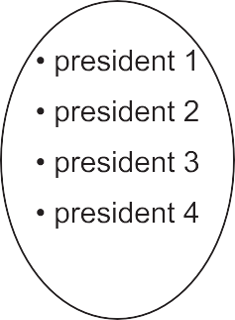
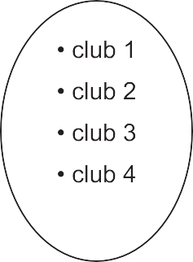
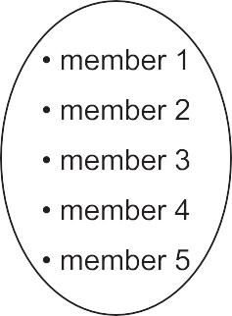
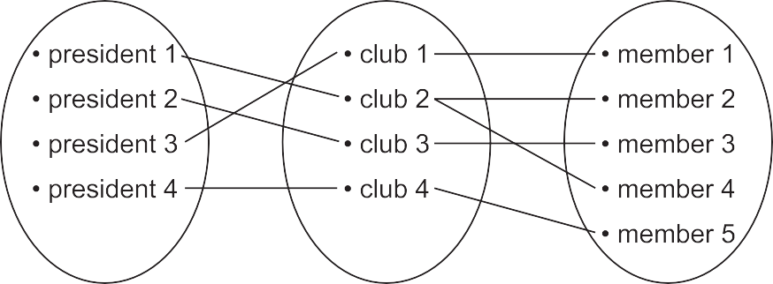
36 TOPIC 2. DESIGN
Figure 2.6: Entity Occurrence Diagram - dummy data
As shown, you would lay this out as having three entity sets and a number of values within them. Then join the values together following the logic for the system.
Figure 2.7: Entity Occurrence Diagram - dummy data - solution
This shows that the relationship between President and Club is 1:1 (one-to-one) and that the relationship between club and member is 1:M (one-to-many).
© HERIOT-WATT UNIVERSITY

Slide 39





TOPIC 2. DESIGN
37
Activity: Entity Occurrence Diagrams
An online ordering system makes use of four entities. These are Customer, Order, OrderLine
and Product.
Three example orders with the associated data are shown.
Order 1
© HERIOT-WATT UNIVERSITY

Slide 40




Slide 41




TOPIC 2. DESIGN
39
Order 3
Q12: Create an entity occurrence diagram from the information above. You will be required to identify suitable primary keys and their values and link these to understand the relationships between the four entities.
Create your diagram and then list the relationships between each of the entities.
© HERIOT-WATT UNIVERSITY

Slide 42
40 TOPIC 2. DESIGN
2.5 Compound keys
In some relations there is no one column that can act as a primary key. However, each row is unique because of the data values in the columns.
Example
Suit | Value | Number of times played
Hearts | Ace | 5
Diamonds | 2 | 4
Spades | 3 | 3
Clubs | 5 | 8
Clubs | Jack | 5
In the example, no single column contains a set of unique values.
•
•
•
Cards can be any one of four suits so the suit is not unique.
There are four cards in each deck with the same value (four aces, four kings etc.).
The Number of times played attribute won't be unique as it is a count of the number of times the card is played and cards will quite likely be played the same number of times.
This means that none of the columns can serve as a primary key on its own, but what if we used two columns together? Using the Suit and Value columns together as a key would give a unique value for each card.
This combination of columns is our primary key. This is an example of a compound key. When writing the attributes, both would be underlined:
Suit Value
Number of times played
More than one attribute is underlined; therefore you know that this is a compound key.
It is often the case that several columns will have to be used to create a compound primary key. Let's look at this example of people coming to visit properties to buy.
property id | client name | potential buyer no | potential buyer name | date of viewing
P221 | Smith | 282 | Jones | 17.07.2018
P221 | Smith | 982 | Perkins | 19.07.2018
P221 | Smith | 983 | Patel | 29.07.2018
P221 | Smith | 282 | Jones | 29.07.2018
P226 | Parker | 282 | Jones | 29.07.2018
P226 | Parker | 225 | Mitchell | 23.08.2018
© HERIOT-WATT UNIVERSITY

Slide 43
TOPIC 2. DESIGN
41
There are no unique columns:
•
•
because a property can be viewed more than once, property-id and client-name are repeated; because one potential buyer can view one or more properties on several different occasions,
potential-buyer-no and potential-buyer-name can appear more than once;
because any house can be visited more than once on the same day, the date-of-viewing is repeated. Note that the same person cannot view the same house twice on the same day.
•
This means that none of the columns can serve as a primary key on its own. However, a combination of property-id, potential-buyer-no and date-of-viewing is unique. This is because the combination of values in each of these three columns is never the same.
Quiz: Compound keys Go online
Q13: Examine the following table and select a suitable compound primary key.
competitionID | position | points | gamerID
1 | 1 | 1500 | 9023
1 | 2 | 7000 | 1873
1 | 3 | 1000 | 1009
2 | 1 | 12000 | 0293
2 | 2 | 6000 | 3742
2 | 3 | 1500 | 1645
3 | 1 | 30000 | 1873
3 | 2 | 22000 | 9834
3 | 3 | 15000 | 1873
3 | 4 | 5000 | 1842
2.6 Entity relationship diagrams
From your studies at National 5, you will be familiar with creating ERDs with two entities and a single relationship. The problems that you will encounter at Higher level are more complex and will typically involve three or more entities and multiple relationships of different cardinalities (i.e. one-to-one, one-to-many, and many-to-many).
Example
ParcelMe is a delivery company with a company-wide database system. Shipped items are the heart of the ParcelMe product tracking system. Shipped items can be characterised by item number (unique), weight, dimensions, insurance amount, destination, and final delivery
© HERIOT-WATT UNIVERSITY

Slide 44
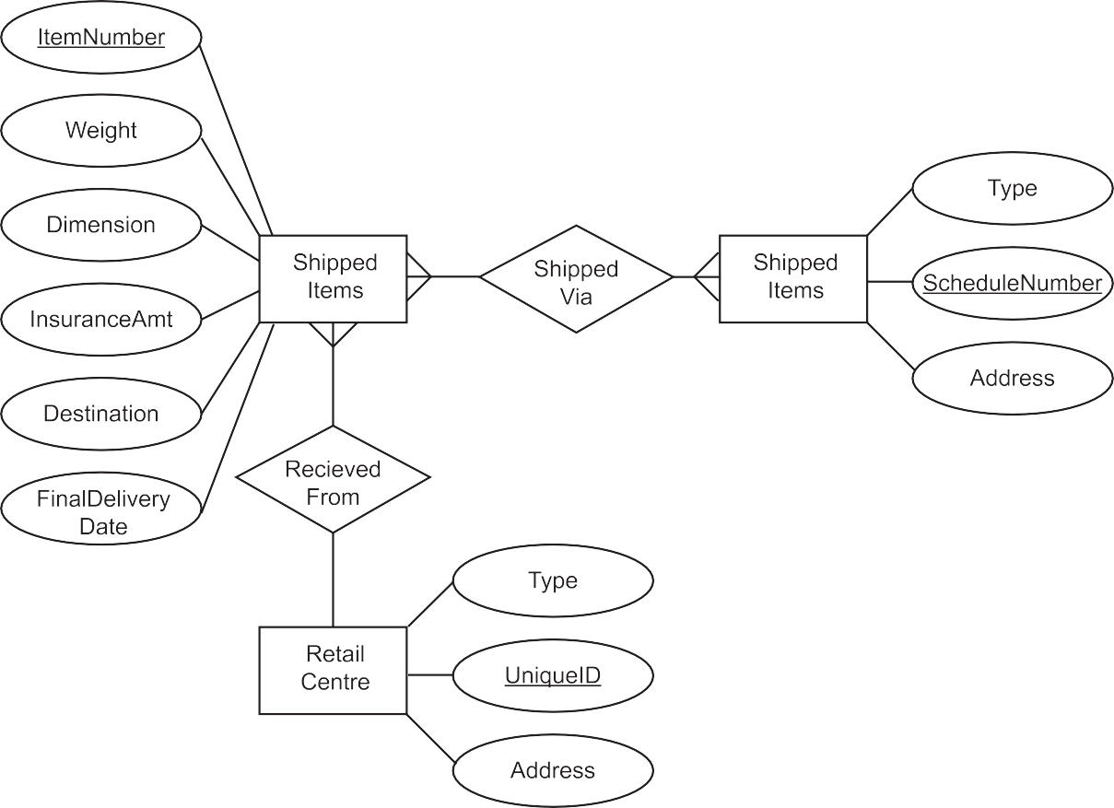

42 TOPIC 2. DESIGN
date. Shipped items are received into the ParcelMe system at a Retail Center. Retail Centers have a type, uniqueID, and address. Shipped items make their way to their destination via one or more standard ParcelMe transportation events (i.e., flights, vehicle deliveries). These transportation events consist of a unique scheduleNumber, a type (e.g, flight, vehicle), and a deliveryRoute.
The ERD for the example system would be:
Figure 2.8: ParcelMe Entity Relationship Diagram
In the diagram, many Shipped Items are shipped through many Transportation Events and one
Retail Centre receives many Shipped Items.
Quiz: Entity relationship diagrams
Create ERDs for the following scenarios.
Q14: A company stores information about employees, departments and the children of employees. The employees details held are employeeID, salary and phone number. Each department has a department number and a budget. Children of employees uses a ChildID, Child Name and Age. Each employee works in only one department and assume that only one parent works at the company.
...............................................
© HERIOT-WATT UNIVERSITY

Slide 45




TOPIC 2. DESIGN
43
Q15: A computer game has teams of players. Each player has a playerID, name and a skill level. Each player has access to an inventory. This inventory includes items to use in the game. Each item has a unique itemID, a name and a cost. Teams play matches against the computer and, for each match, there is a unique MatchID, a score, a match level and a match map. Teams have a team name and teamID. The inventory has a compound primary key of playerID and itemID.
...............................................
Q16: Here is an example of information from a database system.
© HERIOT-WATT UNIVERSITY

Slide 46
44 TOPIC 2. DESIGN
Complete this entity relationship diagram using the labels provided.
customer
order
orderline
product
2.7 Solutions to queries
At Higher level you will be expected to design solutions to a query making use of the following:
•
•
•
•
•
•
tables and queries;
fields;
search criteria;
sort order;
calculations;
grouping.
Tables and queries
From National 5 you will be aware of using tables as the source of the data for your queries. When a query runs on tables it will produce an answer table. Answer tables can also be used as the basis for a query. You can perform a query on the result of a query!
© HERIOT-WATT UNIVERSITY

Slide 47
TOPIC 2. DESIGN
45
Example The Federation of Esports has a relational database that consists of three linked tables, storing data on solo players, tournaments and tournament results.
Extracts from these tables are shown as follows.
tournament:
tournamentID | country | place | eventDate
1 | UK | Liverpool | 13/05/2017
2 | France | Paris | 29/08/2017
3 | USA | New York | 08/09/2017
4 | Germany | Berlin | 12/03/2018
... | ... | ... | ...
player:
playerID | forename | surname | rating | playercountry
1645 | Barry | Jones | 1756 | USA
1873 | Jenny | McKay | 1260 | Australia
2093 | Ahmed | Ali | 1934 | UK
... | ... | ... | ... | ...
result:
tournamentID | position | prizemoney | playerID*
1 | 1 | 15000 | 1645
1 | 2 | 7000 | 1873
1 | 3 | 1000 | 2093
2 | 1 | 12000 | 1873
2 | 2 | 6000 | 2093
2 | 3 | 1500 | 2093
3 | 1 | 30000 | 1873
3 | 2 | 22000 | 2093
3 | 3 | 15000 | 0293
... | ... | ... | ...
© HERIOT-WATT UNIVERSITY

Slide 48
46 TOPIC 2. DESIGN
A query is designed to show all the results for "Jenny Mckay"
Query1
Tables(s) and/or query | player, result
Fields and/or calculations | position, prizemoney
Search criteria | forename = "Jenny", surname = "Mckay", player.playerid = result.playerid
Grouping
Sort order
The answer table generated by this query would then be used to find the largest sum of prize money that Jenny Mckay won when she finished in first in a tournament (position 1).
Query2
Tables(s) and/or query | [All results for Jenny Mckay]
Fields and/or calculations | MAX(prizemoney)
Search criteria | position = 1
Grouping
Sort order
This query acts on the results of Query 1 to produce a second answer table where the position
= 1.
Fields
Fields in a database table are the columns of data. Each column has a unique name within the table. When designing a query you need to consider the fields that will appear in the answer table. There may be other fields that you use for search criteria, grouping and sort order but these are the fields (the columns) which are displayed in the answer table generated by the query.
Search criteria
Search criteria are field values that are used to reduce the scope of a query and select the required data. In the example above the search criteria for Query 1 are forename = "Jenny", surname = "Mckay", player.playerid = result.playerid. In an SQL query these would be joined together using an AND operator (or some other operator depending on the data that the query should generate). The criteria 'player.playerid = result.playerid' is the criteria that is used to link the two tables in the query.
We will cover more on the detail of Search Criteria in the next topic.
Sort order
The answer table produced by a query can be sorted based on values held in the columns. Answer tables can sorted on one, two or more fields in ascending or descending orders.
© HERIOT-WATT UNIVERSITY

Slide 49
TOPIC 2. DESIGN
47
Example
The following answer table is sorted on: year descending, comic-id ascending, hero-name ascending
Year | comic id | hero name
2017 | 6171 | Aqua matrix
2017 | 6171 | Super mole
2017 | 8109 | Jules Volt
2017 | 8109 | Rocket
2016 | 5261 | Bear Meteor
2016 | 5261 | No Capes
2016 | 5278 | X-field
2015 | 9188 | Superflea
2015 | 9188 | Transfirma
Calculations
Calculations can be carried out within a query. These calculations can use field values to generate new values that can be displayed in the answer table.
Example
A query uses the data from the following table:
OrderID | ItemID | Qty | BasePrice
00928 | 1726 | 5 | 9.99
00928 | 1727 | 2 | 17.50
00929 | 1726 | 1 | 29.00
00930 | 2817 | 20 | 5.75
We can design a calculation that can be carried out on this table as part of the query.
We can calculate the Qty multiple by the BasePrice. We can also give this calculation a name which will be used in the answer table.
Tables(s) and/or calculations
(Qty * Base Price) as LineTotal
The answer table would then be:
LineTotal
49.95
35
29
© HERIOT-WATT UNIVERSITY

Slide 50
48 TOPIC 2. DESIGN
It is also possible to use functions to carry out calculations. You need to know the following functions for higher level.
•
Minimum
Find the minimum of the values available. Use the notation MIN(fieldname) in your design.
•
Maximum
Find the maximum of the values available. Use the notation MAX(fieldname) in your design.
•
Average
Calculates the average of all the values available. Use the notation AVG(fieldname) in your design.
•
Sum
Adds together all the values available. Use the notation SUM(fieldname).
•
Count
Counts the number of occurrences of a field. Use the notation COUNT(fieldname).
Grouping
Grouping gathers together the rows of a table or answer table based on a column or columns with the same value or values.
Examples
1.
The result table from an earlier example is given here.
result:
tournamentID | position | prizemoney | playerID*
1 | 1 | 15000 | 1645
1 | 2 | 7000 | 1873
1 | 3 | 1000 | 2093
2 | 1 | 12000 | 1873
2 | 2 | 6000 | 2093
2 | 3 | 1500 | 2093
3 | 1 | 30000 | 1873
3 | 2 | 22000 | 2093
3 | 3 | 15000 | 0293
... | ... | ... | ...
© HERIOT-WATT UNIVERSITY

Slide 51
TOPIC 2. DESIGN
49
A query design with grouping is shown.
Tables(s) and/or query | tournament
Fields and/or calculations | tournamentid, SUM(prizemoney) as PrizeFund
Search criteria
Grouping | BY tournamentid
Sort order
This will total all the prizemoney values for each tournament value. generated will be:
The answer table
tournamentID | PrizeFund
1 | 23000
2 | 19500
3 | 67000
...............................................
2.
This a table of customers for a company.
CustomerID | CustomerName | Address | City | PostCode | Country
12 | Island Trading | Garden House Crowther Way | Cowes | PO31 7PJ | UK
13 | Königlich Essen | Maubelstr. 90 | Brandenburg | 14776 | Germany
14 | La corne d'abondance | 67, avenue de l'Europe | Versailles | 78000 | France
15 | La maison d'Asie | 1 rue Alsace- Lorraine | Toulouse | 31000 | France
16 | Laughing Bacchus Wine Cellars | 1900 Oak St. | Vancouver | V3F 2K1 | Canada
17 | Lazy K Kountry Store | 12 Orchestra Terrace | Walla Walla | 99362 | USA
18 | Lehmanns Marktstand | Magazinweg 7 | Frankfurt a.M. | 60528 | Germany
19 | Let's Stop N Shop | 87 Polk St. Suite 5 | San Francisco | 94117 | USA
© HERIOT-WATT UNIVERSITY

Slide 52
50 TOPIC 2. DESIGN
CustomerID | CustomerName | Address | City | PostCode | Country
20 | LILA- Supermercado | Carrera 52 con Ave. Bolívar #65-98 Llano Largo | Barquisimeto | 3508 | Venezuela
21 | LINO- Delicateses | Ave. 5 de Mayo Porlamar | I. de Margarita | 4980 | Venezuela
22 | Lonesome Pine Restaurant | 89 Chiaroscuro Rd. | Portland | 97219 | USA
23 | Magazzini Alimentari Riuniti | Via Ludovico il Moro 22 | Bergamo | 24100 | Italy
24 | Maison Dewey | Rue Joseph-Bens 532 | Bruxelles | B-1180 | Belgium
25 | Mère Paillarde | 43 rue St. Laurent | Montréal | H1J 1C3 | Canada
26 | Morgenstern Gesundkost | Heerstr. 22 | Leipzig | 04179 | Germany
27 | North/South | South House 300 Queensbridge | London | SW7 1RZ | UK
28 | Océano Atlántico Ltda. | Ing. Gustavo Moncada 8585 Piso 20-A | Buenos Aires | 1010 | Argentina
29 | Old World Delicatessen | 2743 Bering St. | Anchorage | 99508 | USA
A query design with grouping as shown here:
Tables(s) and/or query | Customer
Fields and/or calculations | Count(CustomerID), Country
Search criteria
Grouping | BY country
Sort order
© HERIOT-WATT UNIVERSITY

Slide 53
TOPIC 2. DESIGN
51
Will produce the answer table:
COUNT(CustomerID) | Country
1 | Argentina
1 | Belgium
2 | Canada
2 | France
3 | Germany
1 | Italy
2 | UK
4 | USA
2 | Venezuela
2.8 Learning points
Summary
You should now be able to:
•
•
create and describe entity-relationship diagrams using three or more entities;
exemplify relationships and their cardinality as one-to-one, one-to-many or many-to- many;
•
use entity-occurrence diagrams to identify and present the relationship between two entities;
describe and explain through examples, a compound key;
describe and explain through examples, a data dictionary with three or more entities including attribute names, types, size and validation;
design, create and explain the design of a solution to a query, making use of tables, queries, fields, search criteria, sort order, calculations and grouping.
•
•
•
© HERIOT-WATT UNIVERSITY

Slide 54
52 TOPIC 2. DESIGN
2.9 End of topic test
End of Topic 2 test
Go online
Q17: Which of the statements is the correct definition of a primary key?
An attribute that is the same for all the entities.
The longest attribute within an entity.
The shortest attribute within an entity.
An attribute that has a unique value for each entity.
...............................................
Q18: Which of the statements is the correct definition of a foreign key?
An attribute that is the primary key of another entity set.
The attribute field within an entity.
The most important attribute in an entity.
An attribute in a foreign language.
...............................................
Q19: Which of these is not a type of relationship?
One-to-many
One-to-several
One-to-one
Many-to-many
...............................................
Q20: Grouping in a query design:
display values from the same column grouped with equivalent values in another column.
calculates a summary value for each column and displays this.
gathers together the rows of a table or answer table based on a column or columns with the same value or values.
creates a relationship between two answer tables and display the result from the two
tables.
...............................................
Q21: A compound key is:
a combination of a primary and foreign key to link to entity sets.
a combination of more than one attribute to uniquely identify an entity.
an attribute of the entity that is important and will be indexed to ensure fast access within search.
is a unique identifier for an entity that consists on a single attribute.
© HERIOT-WATT UNIVERSITY

Slide 55
Implementation
53
Topic 3
Contents
.
3.1 Application software . . . . . . . . . . | . . . . . . . . |  | . . . | . . . . . |  | . . . . . | . . . . | . . . | . . | 55
3.2 Introduction . . . . . . . . . . . . . . . | . . . . . . . . . |  | . . . | . . . . . |  | . . . . . | . . . . | . . . | . . | 59
3.2.1 Referential integrity . . . . . . | . . . . | . . . | . . . | . . . . . |  | . . . . | . . . | . . . . . |  | 59
3.2.2 SQL operations: SELECT . . . | . . . . | . . . | . . . | . . . . . |  | . . . . | . . . | . . . . . |  | 61
3.2.3 SQL operations: INSERT . . . | . . . . | . . . | . . . | . . . . . |  | . . . . | . . . | . . . . . |  | 66
3.2.4 SQL operations: UPDATE . . . | . . . . | . . . | . . . | . . . . . |  | . . . . | . . . | . . . . . |  | 67
3.2.5 SQL operations: DELETE . . . | . . . . | . . . | . . . | . . . . . |  | . . . . | . . . | . . . . . |  | 70
3.3 Example database . . . . . . . . . . . | . . . . | . . . | . . . | . . . . . |  | . . . . . | . . . . | . . . | . . | 72
3.4 SQL Wildcards . . . . . . . . . . . . . | . . . . . | . . . . | . . . | . . . . . |  | . . . . . | . . . . | . . . | . . | 74
3.5 Table and column aliases . . . . . . . | . . . . | . . . | . . . | . . . . . |  | . . . . | . . . | . . . | . . | 76
3.6 Using sub-queries . . . . . . . . . . . | . . . . | . . . | . . . | . . . . . |  | . . . . . | . . . . | . . . | . . | 77
3.7 SQL aggregate functions (MIN, MAX, AVG, SUM, COUNT) |  |  |  | . . | . . . | . . . . | . . . | . . . | . . | 80
3.8 Computed values . . . . . . . . . . . . . . . . . . . . . . . |  |  |  | . . | . . . | . . . . . | . . . . | . . . | . . | 82
3.9 GROUP BY . . . . . . . . . . . . . . . . . . . . . . . . . . . |  |  |  | . . | . . . | . . . . . | . . . . | . . . | . . | 83
3.10 ORDER BY . . . . . . . . . . . . . . . . . . . . . . . . . . . |  |  |  | . . | . . . | . . . . . | . . . . | . . . | . . | 85
3.11 Learning points . . . . . . . . . . . . . . . . . . . . . . . . |  |  |  | . . | . . . | . . . . . | . . . . | . . . | . . | 86
3.12 End of topic test . . . . . . . . . . . . . . . . . . . . . . . . |  |  |  | . . | . . . | . . . . . | . . . . | . . . | . . | 87
.
.
.
.
.
.
.
.
.
.
.
.
.
.
.
.
.
.
.
.
.
.
.
.
.
.
.
.
.
.

Slide 56
54 TOPIC 3. IMPLEMENTATION
Prerequisites
From your studies at National 5 you should already know how to:
•
implement relational databases with two linked tables to match a design with referential integrity;
describe, exemplify and implement SQL operations for pre-populated relational databases, with a maximum of two linked tables using SELECT, INSERT, UPDATE, DELETE queries;
•
•
use:
◦
◦
◦
◦
FROM, WHERE and ORDER BY clauses within queries; WHERE clauses which make use of AND, OR, <, >, =;
ORDER BY clauses which make use of a maximum of two fields; equi-joins to select data from two tables.
Learning objective
By the end of this topic you should be able to:
•
describe, exemplify and use SQL operations for pre-populated relational databases, with three or more linked tables;
use:
•
◦
UPDATE, SELECT, DELETE and INSERT statement on more complex related tables;
wildcards in your queries;
aggregated functions MIN, MAX, AVG, SUM and COUNT to process data using queries;
GROUP BY clauses to gather data of similar values together; ORDER BY clauses to sort answer tables on multiple fields;
◦
◦
◦
◦
•
•
make more complex use of WHERE clauses to select data;
use sub-queries so that the answer table generated by a previous query can be used as the basis for a further query;
read and explain SQL statements which makes use of the above points.
•
© HERIOT-WATT UNIVERSITY

Slide 57
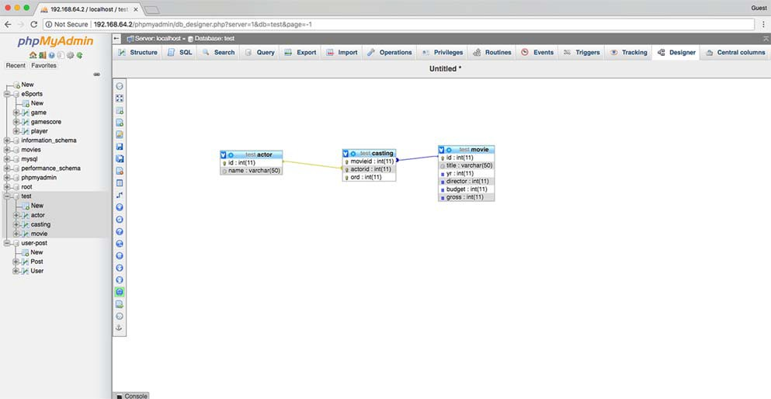
TOPIC 3. IMPLEMENTATION
55
3.1 Application software
You will require access to a RDBMS which supports the use of SQL commands for this Topic. There are many technologies that support the use of SQL commands.
MySQL / MariaDB
MySQL is an open-source relational database management system (RDBMS) and one of the most popular applications used to build databases on the web and other systems. MariaDB is a different version (fork) of MySQL which developers have chosen to develop in a different direction. Both these applications are high-performance RDBMSs that can be used for this course.
You can use these applications from the command line however a common method is to use an application such as phpMyAdmin or MySQLWorkBench
Figure 3.1: Design View within phpMyAdmin
© HERIOT-WATT UNIVERSITY

Slide 58
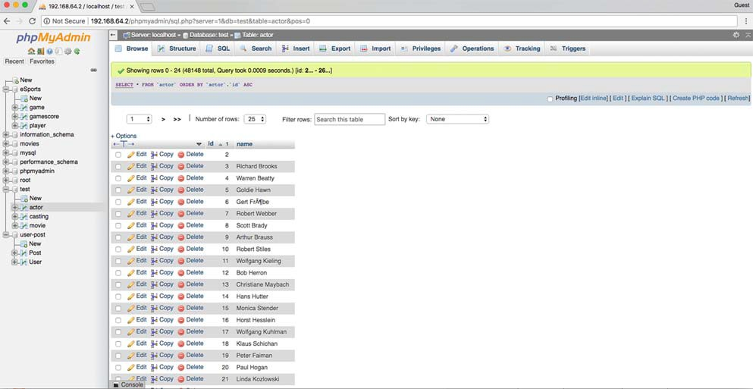
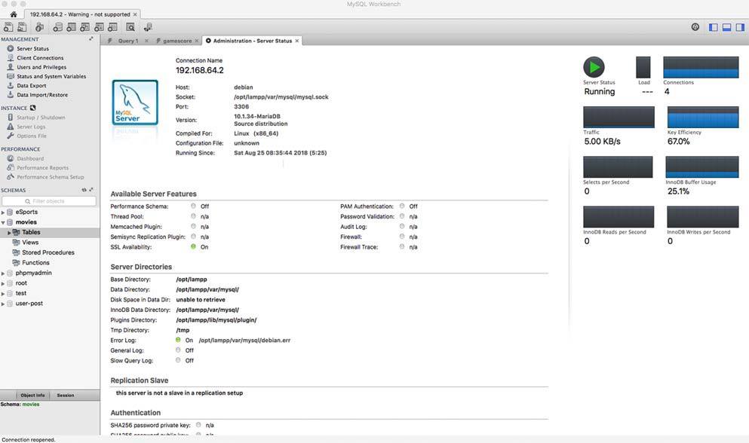
56 TOPIC 3. IMPLEMENTATION
Figure 3.2: Browsing a table in phpMyAdmin
Figure 3.3: Screen from MySQL WorkBench
© HERIOT-WATT UNIVERSITY

Slide 59
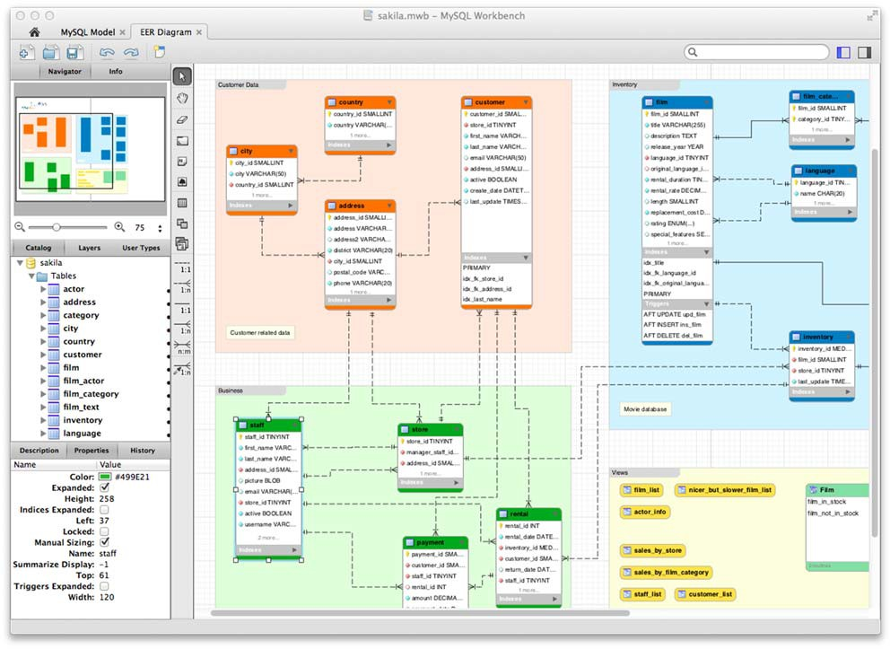
TOPIC 3. IMPLEMENTATION
57
Figure 3.4: Relationships Screen from MySQL WorkBench
© HERIOT-WATT UNIVERSITY

Slide 60
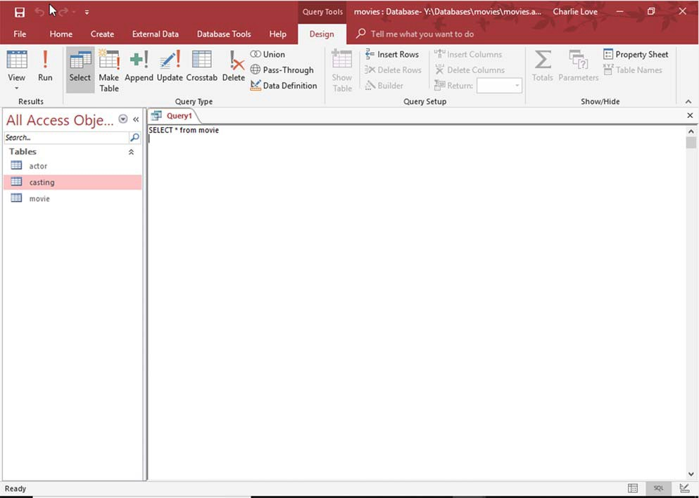
58 TOPIC 3. IMPLEMENTATION
SQL view within Microsoft Access
Within Microsoft Access is the Query View. This view allows access to a SQL editor for you enter commands. Queries can be entered here and then run.
Figure 3.5: SQL Window within Query View in Microsoft Access
*AMP Stack
*AMP is a term used to define a combination of operating system, Apache Web Server, MySQL or MariaDB database server and PHP. The popularity of *AMP across the World Wide Web is driven by the low-cost of deployment; the components of *AMP (other than the operating system) are Open-Source applications, free software that can be used without purchasing a license.
Versions of the *AMP stack can be downloaded for Windows, MacOS X and Linux at no cost from:
•
•
•
XAMMP: https://www.apachefriends.org/
MAMP: https://www.mamp.info/
WampServer: http://www.wampserver.com/en/
MySQL or MariaDB is the key database component of *AMP and dominates online databases used to provide services. There are over 10 million active installations of MySQL/Maria DB and it is the database technology that drives popular web tools such as Wordpress, Tumblr and Twitter.
If you are using phpMyAdmin then you will likely have access to an *AMP stack.
© HERIOT-WATT UNIVERSITY

Slide 61
TOPIC 3. IMPLEMENTATION
59
  Introduction
From National 5 Computing Science you should already be familiar with queries which manipulate data from two linked tables.
These linked tables are connected by a primary / foreign key and adhere to referential integrity.
    Referential integrity
Referential integrity means that the relationship between two tables should always be consistent. A foreign key is a primary key value from another table.
Figure 3.6: One-to-many relationship with primary and foreign keys
In the example above, the UserID is the primary key of the User table and is a foreign key in the
Post table. If the row for NKSL was removed, then the table would be as follows.
© HERIOT-WATT UNIVERSITY

Slide 62
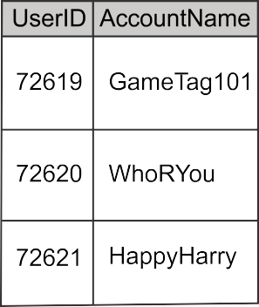
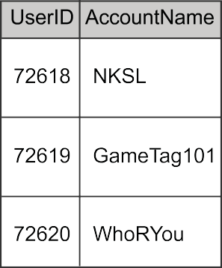
60 TOPIC 3. IMPLEMENTATION
Figure 3.7: One-to-many relationship with primary and foreign keys without referential integrity
In this example, there is no primary key value for the foreign key value 72618. Deleting the row for NKSL creates inconsistent rows in the Post table. It breaks the link between the two tables.
Enforcing referential integrity means that there cannot be foreign key values that do not have a corresponding primary key value in the linked table. It prevents breaking the link between primary and foreign keys in related tables. It also prevents new rows being added in a table where the foreign key does not have a matching primary key value in the linked table.
If referential integrity is enforced then removing a row that has the primary key value, should also delete all the rows in the linked table with the related foreign key. This process is called "cascade deletion". So, deleting the row for HappyHarry in the User table will also delete all the related rows in the Post table e.g.
Figure 3.8: Cascaded deletions
In the rare occasion that there is a need to update the primary key value, then it is important that all the linked foreign keys are also updated. This process is called "cascade update". Any changes to a primary key value are also copied to all the related foreign key values. If the primary key for GamerTag101 is changed from 72619 to 89212 then all the related foreign key values are also
© HERIOT-WATT UNIVERSITY

Slide 63
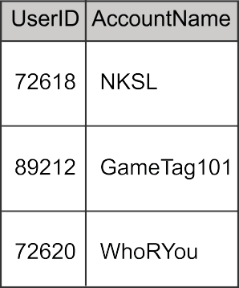
TOPIC 3. IMPLEMENTATION
61
updated e.g.
Figure 3.9: Cascaded updates
3.2.2 SQL operations: SELECT
At National 5 you used SQL operations to query pre-populated databases with two linked tables.
SQL Statements
A single line of an SQL command is called a statement. These statements will consist of one or more clauses. Each clause contains a specific SQL keyword and some data that it acts upon. The following is an example of a statement using the SELECT command which locates and displays data according to the details entered.
1
2
3
4
SELECT userID , AccountName FROM User
WHERE UserID > 70000
ORDER BY AccountName DESC ;
In this example, each clause has been placed on a separate line and the SQL keywords have been capitalised. Notice that the semi-colon (;) is used to terminate the statement. There is no requirement to place a statement across multiple lines or to capitalise commands but for clarity in the following activities this is the approach that will be used.
Practical tasks using SELECT
The following activities make use of a database of Users and Posts.
Download https://courses.scholar.hw.ac.uk/vle/asset/Downloads/H-CCMP/Course%20Downloads/ C45F14CD-EA9B-6478-B678-E3ACFF7C1CE4/SELECT.zip, extract the files and then do one of the following, depending on your database management system:
•
•
•
import user-post.sql to an empty database to create the complete database;
open user-post.accdb in Microsoft Access;
CSV files users.csv and posts.csv are available for each database table for conversion to other platforms.
© HERIOT-WATT UNIVERSITY

Slide 64




62 TOPIC 3. IMPLEMENTATION
You will require an RDMS, such as MariaDB/MySQL (PhpMyAdmin) or Microsoft Access, to enter SQL commands and to run these to produce answer tables.
Activity: Using SELECT (1)
Enter the SQL: SELECT * FROM User;
This will display an answer table containing all columns and rows from the User table. The asterisk (*) is a wildcard that means EVERYTHING.
Q1: Write the SQL to display everything from the Post table.
Activity: Using SELECT (2)
Enter the SQL: SELECT AccountNarne FROM User;
This will display the AccountName column for all the rows from the User table.
Q2: Write the SQL to display just the UserID from the Post table.
Activity: Using SELECT (3)
Enter the SQL: SELECT PostID, PostContent FROM Post;
This will display the PostID and PostContent columns from the Post table.
Q3: Write the SQL to display just the UserID and PostContent from the Post table.
Activity: Using SELECT (4)
Enter the SQL: SELECT * FROM User, Post;
This shows the rows from each table with every row from the corresponding table. Without a JOIN the query doesn't work.
The type of join you know from National 5 is EQUI-JOIN which is an equal join between the tables. The equi-join is the "link" between the primary and foreign keys. In this case, the primary key User.UserID and foreign key Post.UserID.
Q4: Write the SQL to display all the columns from both tables where there the value of the primary key (User.UserID) is the same as the foreign key (Post.UserID).
© HERIOT-WATT UNIVERSITY

Slide 65


TOPIC 3. IMPLEMENTATION
63
Activity: Using SELECT (5)
Enter the SQL:
1
2
3
SELECT * FROM User , Post
WHERE User . U serID = Post . UserID AND AccountName = 11 WhoRYou 11;
AND is used to apply both parts of the WHERE clause. This query displays all the columns from both tables for a user with the AccountName "WhoRYou".
Q5: Write the SQL to display all the columns for the PostID with a value of 281756.
Activity: Using SELECT (6)
Enter the SQL:
1
2
SELECT * FROM User WHERE UserID > 72631;
This will display all the columns where the User ID is greater than 72631.
Q6: Write the SQL to display all the columns from the Post table where the PostID is less than 281749.
© HERIOT-WATT UNIVERSITY

Slide 66

64 TOPIC 3. IMPLEMENTATION
Activity: Using SELECT (7)
Enter the SQL:
1
2
SELECT * FROM User
WHERE UserID < 72620 OR UserID > 72658;
OR is used to connect the two conditions. This query will find all rows for UserIDs that are less than 72620 or where they are greater than 72658.
Q7: Write the SQL to display the PostID and PostContent from the Post table where the PostID is either less than 281722 or greater than 281954.
Activity: Using SELECT (8)
Enter the SQL:
1
2
3
SELECT * FROM User , Post
WHERE User . U serID = Post . UserID
AND ( Post . UserID < 72620 OR Post . UserID > 72658) ;
This is a little more complicated. The equi-join between the two tables is established using the User.UserID = Post.UserID. The conditions, UserID < 72620 OR UserID > 72658, are written inside curved brackets.
We want BOTH of the conditions to be true AND we want the join to be true as well. Because of the brackets, the query will find all the matching values for UserID first and then find the values that match for the relationship.
Q8: Write the SQL to display the AccountName and PostContent from the User and Post tables where the PostID is equal to either 281821 or 281829.
Activity: Using SELECT (9)
Enter the SQL:
1
2
3
SELECT *
FROM User
ORDER BY AccountName DESC ;
Results in answer tables can be sorted on one or more columns. These columns can be placed in ascending or descending order. This query sorts the rows of the User table into descending order of AccountName.
Q9: Write the SQL to display sorted rows from the Post table in ascending order of UserID.
© HERIOT-WATT UNIVERSITY

Slide 67

TOPIC 3. IMPLEMENTATION
65
Activity: Using SELECT (10)
Enter the SQL:
1
2
3
SELECT *
FROM Post
ORDER BY UserID DESC , PostContent ASC ;
This places all the rows into order by UserID descending (from biggest number to smallest) and, where the UserID values are the same, places the PostContent column into alphabetical order ascending.
Q10: Write the SQL to display sorted rows from the Post table in ascending order of UserID ascending and then PostID descending.
Activity: Using SELECT (11)
Enter the SQL:
1
2
3
4
SELECT *
FROM Post
WHERE PostID = 281763 OR PostID = 281765 OR PostID = 281768
ORDER BY UserID DESC , PostContent ASC ;
This places all the rows into order by UserID descending (from biggest number to smallest) and, where the UserID values are the same, places the PostContent column into alphabetical order ascending.
Q11: Write the SQL to display sorted rows from the Post table in ascending order of UserID ascending and then PostContent descending where PostID is greater than 281952.
Activity: Using SELECT (12)
Enter the SQL:
SELECT AccountName ,
FROM User , Post
WHERE User . U serID =
AND ( P ostID =
ORDER BY Post . U serID DESC , PostContent ASC ;
This combines all the clauses that we used previously. It selects the columns AccountName from the User table and PostID, PostContent from the Post table.
It implements the equi-join between the two tables (User.UserID = Post.UserID) and uses OR to select three matching PostIDs.
PostID , PostContent
Post . UserID
281763 OR PostID = 281765 OR PostID = 281768)
© HERIOT-WATT UNIVERSITY

Slide 68
66 TOPIC 3. IMPLEMENTATION
The results are then sorted by UserID descending and PostContent ascending.
Q12: Write the SQL to display the UserID and the PostID where the UserID is greater than 72656. Sort the results by UserID ascending and PostID ascending.
3.2.3 SQL operations: INSERT
The INSERT command is used to add a row or rows to a table. The format of the command is:
1
2
INSERT INTO table ( column1 , column2 , column3 , ...) VALUES (value1 , value2 , value3 , ...) ;
If you are adding values for all the columns of the table, you do not need to specify the column names in the SQL query. However, make sure the order of the values is in the same order as the columns in the table.
The statement to add a new row, with the value 72661 for UserID and "shadow99" for AccountName, to the User table would be:
1
2
INSERT INTO User
VALUES (72661 , 11 shadow99 11) ;
The INSERT command can be used to add more than one row at the same time. For example:
1
2
3
4
INSERT INTO User
VALUES (72661 , 11 shadow99 11) ,
(72662 , 11G o o d 1 0 1 11) ,
(72663 , 11 B lakeyBoy11) ;
Key point
Multiple Insert Value clauses are not supported by Microsoft Access. If you are using Microsoft Access then you can create an INSERT statement for each row of data to be entered.
The INSERT command also change the order of the column values being added. For example:
1
2
INSERT INTO User ( A ccountName , UserID ) VALUES (11 shadow9911 , 72661) ;
Practical tasks using INSERT
The following activities make use of a database of Users and Posts. You previously used this database for the tasks using the SELECT command. If you have not already downloaded the necessary files, download https://courses.scholar.hw.ac.uk/vle/asset/Downloads/H-CCMP/Course
%20Downloads/C45F14CD-EA9B-6478-B678-E3ACFF7C1CE4/SELECT.zip, extract the files and then carry out one of the following actions with your RDMS:
© HERIOT-WATT UNIVERSITY

Slide 69

TOPIC 3. IMPLEMENTATION
67
•
•
•
import user-post.sql to an empty database to create the complete database;
open user-post.accdb in Microsoft Access;
CSV files users.csv and posts.csv are available for each database table for conversion to other platforms.
This section will add new rows to both tables.
Activity: Using INSERT (1)
Enter the SQL:
1
2
INSERT INTO User
VALUES (72661 , 11 shadow99 11) ;
This will insert a row with the value 72661 for UserID and "shadow99" for AccountName.
Q13: Write the SQL to insert a new user with a UserID of 72662 and the AccountName of "Good101".
Activity: Using INSERT (2)
Enter the SQL:
1
2
INSERT INTO Post
VALUES (72661 , 281957 , 11Wow , So many newbies in Fortnite .11 );
This will insert a row in the Post table.
Q14: Write the SQL to insert a new post with the following values. UserID: 72662
PostID: 281958
PostContent: "I so need a Durr Burger Skin!!"
3.2.4 SQL operations: UPDATE
The UPDATE command is used to amend rows in a table. It can be used to update multiple rows at the same time and can make use of WHERE clauses to select the data to be updated. The syntax of UPDATE command is:
1
2
3
UPDATE table
SET column1 = value1 , column2 = value2 , ... WHERE condition;
© HERIOT-WATT UNIVERSITY

Slide 70
68 TOPIC 3. IMPLEMENTATION
Key point
The WHERE clause in the UPDATE statement is really important. If you forget it and just run UPDATE without, you will update EVERY row in your table and lose all your data!
© HERIOT-WATT UNIVERSITY

Slide 71
TOPIC 3. IMPLEMENTATION
69
The statement to update the AccountName for "shadow99" to "Shatterwind" would be:
1
2
3
UPDATE User
SET AccountName = 11 S hatterwind11 WHERE AccountName = 11 shadow99 11;
The INSERT command can update more than one record at a time. For example, all the posts for the AccountName "WhoRYou" (UserID 72620) should have been linked to "Good101". User "Good101" has a UserID of 72662.
1
2
3
UPDATE Post
SET UserID = 72662 WHERE UserID = 72620;
This will update nine rows with the new UserID value of 72662. Another way to do the same update would be to use linked tables. When an UPDATE query references two tables, it will only ever update the first table listed.
1
2
3
UPDATE Post , User
SET Post . U serID = 72662
WHERE Post . UserID = User . UserID AND AccountName = 11 WhoRYou 11;
Cascade updates
If your RDBMS does not automatically cascade updates to enforce referential integrity, then you will have to do this manually. So, changing the value for a primary key:
1
2
3
UPDATE User
SET UserID = 72617 WHERE UserId = 72618;
Would require the following query to also be run to update the related foreign key values in the Post table.
1
2
3
UPDATE Post
SET UserID = 72617 WHERE UserId = 72618;
Activity: Using UPDATE (1)
Enter the SQL:
1
2
3
UPDATE User
SET AccountName = 11 S hatterwind11 WHERE AccountName = 11 shadow99 11;
This will update the AccountName where the current value is "shadow99" and replace it with "Shatterwind".
Q15: Write the SQL to update the AccountName "QuietRam" to "RohanBear".
© HERIOT-WATT UNIVERSITY

Slide 72
70 TOPIC 3. IMPLEMENTATION
Activity: Using UPDATE (2)
Enter the SQL:
1
2
3
UPDATE Post
SET UserID = 72662 WHERE UserID = 72620;
This will update the UserID where the current value is "72620" and replace it with "72662".
Q16: Write the SQL to update the UserID in the posts table to 72645 where the current value is 72634.
Activity: Using UPDATE (3)
Enter the SQL:
1
2
3
UPDATE Post
SET PostContent = 11K ind of like Lukewarm Water 11 WHERE PostID = 281721;
This will update the PostContent column where the current value of PostID is 281721.
Q17: Write the SQL to update the PostContent, of the row with PostID of 281758, to "Best leave it unsolved.".
3.2.5 SQL operations: DELETE
The DELETE command is used to delete rows in a table. It can be used to delete multiple rows at the same time and makes use of WHERE clauses to select the data to be deleted. The syntax of the DELETE command is:
1
2
DELETE FROM table WHERE condition;
Key point
The WHERE clause in the DELETE statement is really important. If you forget it and just run DELETE without it, you will delete every row in your table.
To delete the Post with PostID of 281767 would require this query statement.
1
2
DELETE FROM Post
WHERE PostId = 281767;
© HERIOT-WATT UNIVERSITY

Slide 73
TOPIC 3. IMPLEMENTATION
71
To delete the all the posts for UserID of 72622 would require this query statement.
1
2
DELETE FROM Post
WHERE UserID = 72622;
Cascade deletes
If referential integrity is not enforced by your RDBMS, then you will have to ensure that it is maintained manually. So, if you delete a primary key value from User, you need to delete the related foreign key rows of Post.
1
2
DELETE FROM User
WHERE UserID = 7264;
Removing this row from the User table would require that the following query is carried out on the Post table.
1
2
DELETE FROM Post
WHERE UserID = 72640;
You can delete data using linked tables. Again, this will only delete data from the first listed table.
1
2
DELETE FROM Post , User
WHERE Post . UserID = User . UserID AND AccountName = 11 ChainToffee 11;
Activity: Using DELETE (1)
Enter the SQL:
1
2
DELETE FROM Post
WHERE PostId = 281767;
Q18: Write the SQL to DELETE a row from Post where PostID = 281954.
Activity: Using DELETE (2)
Enter the SQL:
1
2
DELETE FROM User
WHERE UserID = 72640;
Now delete the related rows in Post:
1
2
DELETE FROM Post
WHERE UserID = 72640;
Q19: Write the SQL to DELETE the user and posts related to UserID 72660.
© HERIOT-WATT UNIVERSITY

Slide 74
72 TOPIC 3. IMPLEMENTATION
Activity: Using DELETE (3)
Enter the SQL:
1
2
DELETE FROM Post
WHERE PostID > 281774 AND PostID < 281778;
This will delete all the rows with a PostID of more than 281774 and less than 281778.
Q20: Write the SQL to DELETE the posts with a PostID of greater than 281795 and less than 281802.
Activity: Using DELETE (4)
Enter the SQL:
1
2
DELETE FROM Post
WHERE PostID = 281820 OR PostID = 281836;
This will delete the two rows with the PostID values given.
Q21: Write the SQL to DELETE the posts with the following PostIDs: 281838, 281841, 281843 from the Post Table.
3.3 Example database
Exercises for the rest of this Topic will make use of the Movies database. The Movies database is provided with permission from http://sqlzoo.net/. The site contains many SQL exercises that you may wish to view.
Download https://courses.scholar.hw.ac.uk/vle/asset/Downloads/H-CCMP/Course%20Downloads/ 4D0AE6A2-01F6-8137-D618-772AE364ECFC/movies.zip, extract the files and then carry out the following actions using your RDMS:
•
•
•
import movies.sql to an empty database to create the complete database;
open movies.accdb in Microsoft Access;
CSV files actor.csv, casting.csv and movie.csv are available for each database table for conversion to other platforms.
© HERIOT-WATT UNIVERSITY

Slide 75
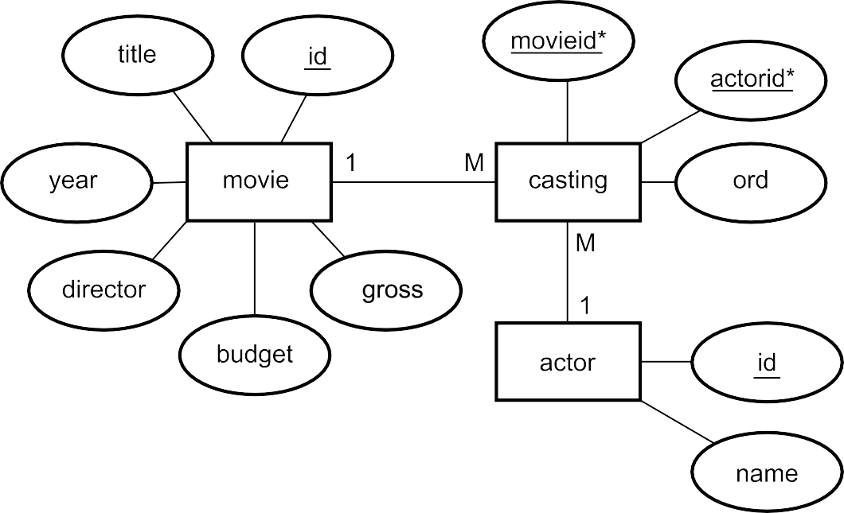
TOPIC 3. IMPLEMENTATION
73
Figure 3.10: Entity Relational Diagram for the movies database
The movies database contains the details of over 48,000 actors, 12,000 movies and 120,000 casting roles. The actor table contains an id and name e.g. id: 6066, name: Mena Suvari.
The movie table has the following columns:
id: title: year:
director: budget:
gross:
Unique id for each row The title of the movie
The year the movie was released
The id (from the actor table) of the director The budget for the movie (where it is known)
How much money the movie grossed (where known). The gross the total income for the movie before costs are deducted.
The casting table has movieid, actorid and ord columns. The movieid contains the foreign key linked to the movie table id. The actorid is linked to the actor table id column. The ord column is the position of the actor in the credits for the movie. The main star would have an ord value of 1, the co-star 2 and so on.
Table 3.1: Sample of data from the Movies database
actor
id | name
3875 | James Whitmore
4058 | Bob Gunton
5353 | Mark Rolston
6152 | Morgan Freeman
6514 | Tim Robbins
8029 | William Sadler
9571 | Clancy Brown
26722 | Gil Bellows
© HERIOT-WATT UNIVERSITY

Slide 76
74 TOPIC 3. IMPLEMENTATION
casting
movieid | actorid | ord
20434 | 3875 | 8
20434 | 4058 | 3
20434 | 5353 | 7
20434 | 6152 | 2
20434 | 6514 | 1
20434 | 8029 | 4
20434 | 9571 | 5
20434 | 26722 | 6
movie
id | title | year | director | budget | gross
20434 | The Shawshank Redemption | 1994 | 41208 | 25000000 | 28341469
The above example shows that Tim Robbins (actor.id value of 6514) is cast in "The Shawshank Redemption" with an ord column value of 1. This means that he appears in the first position in the credits for the movie (because he is the main star of the movie).
3.4 SQL Wildcards
SQL queries can make use of wildcards in a number of ways. From your National 5 course you are already familiar with the * wildcard that can be used to select all columns from the underlying tables in a query.
Wildcards can also be used with the LIKE operator. The LIKE operator is used in a WHERE clause to match specific data in a column. The query SELECT * FROM actor WHERE id LIKE 4058 functions in the same way as SELECT * FROM actor WHERE id = 4058. But using wildcards with the LIKE operator allows us more options.
The wildcards used with the LIKE operator are:
•
•
% - the percent sign represents zero, one, or multiple characters;
- the underscore represents a single character.
Key point
Microsoft Access uses a question mark (?) instead of the underscore ( ). All these examples will use . If using Microsoft Access please substitute a ? where a is shown.
© HERIOT-WATT UNIVERSITY

Slide 77
TOPIC 3. IMPLEMENTATION
75
Table 3.2: Wildcards
SELECT query with LIKE operator |  |  |  |  |  | Description
1 2 3 | SELECT * FROM actor WHERE name | LIKE | 11 C harl % | 11 | ; | Show all rows from the actor table where the name starts with the letters "Charl".
1 2 3 | SELECT * FROM actor WHERE name | LIKE | 11% love 11 | ; |  | Show all rows from the actor table where the name ends with the letters "love".
1 2 3 | SELECT * FROM actor WHERE name | LIKE | 11% L .% 11 ; |  |  | Show all rows from the actor table which contain "L." in any position.
1 2 3 | SELECT * FROM actor WHERE name | LIKE | 11 _ans %11 | ; |  | Shows all rows from the actor table which have "ans" in the second position.
1 2 3 | SELECT * FROM actor WHERE name | LIKE | 11Z_ %_% 11 | ; |  | Shows all rows from the actor table which have at least three characters starting with "Z".
Activity: Using Wildcards
Q22: Write the SQL to display the id and title of the movies with a title of "Star Wars" followed by something e.g. "Star Wars 1: The Phantom Menace"
...............................................
Q23: Write the SQL to display the id and title of the movies with three letter titles.
...............................................
Q24: Write the SQL to display the id and title of the movies which end with the word "Part" followed by two characters. For example, "Atlas Shrugged: Part I".
© HERIOT-WATT UNIVERSITY

Slide 78
76 TOPIC 3. IMPLEMENTATION
3.5 Table and column aliases
Table alias
A table alias is a shortened version of the table name which can be used to refer to columns. This is particularly useful if the SELECT statement contains references to two columns with the same name in different tables.
For example:
1
2
3
SELECT Post . U serID , Post . P ostContent , User . A ccountName FROM User , Post
WHERE User . UserID = Post . U serID ;
This is a long SQL statement but it can be shortened by using table aliases. To create an alias an alternate name for the table is entered after the table name in the FROM clause. So the above SQL statement could be shortened to:
1
2
3
SELECT p. U serID , p . PostContent , u. AccountName FROM User u, Post p
WHERE u. U serID = p . UserID ;
The MySQL keyword AS can be used in the clause for clarity, but it is not a requirement i.e.
1
2
3
SELECT p. U serID , p . PostContent , u. AccountName FROM User AS u, Post AS p
WHERE u. U serID = p . UserID ;
Column alias
A column, calculation or aggregate function can be given an alias within a query. For example, the query:
1
2
3
SELECT UserID , COUNT (*)
FROM Post
GROUP BY UserID ;
Generates this answer table:
UserID | COUNT(*)
72618 | 4
72619 | 7
72621 | 4
72622 | 7
... | ...
It would be better if the COUNT(*) column had a name that was more helpful. This can be done by using the AS operator.
1
2
3
SELECT UserID , COUNT (*) AS 11 N umber of Posts 11 FROM Post
GROUP BY UserID ;
© HERIOT-WATT UNIVERSITY

Slide 79
TOPIC 3. IMPLEMENTATION
77
Now the answer table is:
UserID | Number of posts
72618 | 4
72619 | 7
72621 | 4
72622 | 7
... | ...
The AS operator can be omitted.
1
2
3
SELECT UserID , COUNT (*) 11 Number of Posts 11 FROM Post
GROUP BY UserID ;
This generates the same answer table.
A column alias can be given to any calculated value, aggregated function or column.
3.6 Using sub-queries
Sub-queries are used to use one query as the basis for another query.
So, for example, a query to find the movie with the biggest budget would be:
1 SELECT MAX ( budget ) FROM movie ;
This will display the budget column for the movie that has the largest budget. But if you wanted to know which movie had that budget you could use:
1
2
SELECT title , year , budget FROM movie
WHERE budget = (SE LE C T MAX ( budget ) FROM movie );
This uses the answer to one query as the criteria for another. In this case, it works, because
SELECT MAX(budget) FROM rnovie; only returns a single value.
The query:
1 SELECT * FROM movie WHERE title LIKE 11% Star Wars %11;
... generates an answer table which contains all the movies related to "Star Wars".
© HERIOT-WATT UNIVERSITY

Slide 80
78 TOPIC 3. IMPLEMENTATION
id | title | year | director | budget | gross
17781 | Star Wars: The Clone Wars | 2008 | 37204 | 8500000 | 68284217
17782 | Star Wars Episode I: The Phantom Menace | 1999 | 5969 | 115000000 | 924317558
17783 | Star Wars Episode II: Attack of the Clones | 2002 | 5969 | NULL | NULL
17784 | Star Wars Episode III: Revenge of the Sith | 2005 | 5969 | NULL | 848754768
17785 | Star Wars Episode IV: A New Hope | 1977 | 5969 | 11000000 | NULL
17786 | Star Wars Episode V: The Empire Strikes Back | 1980 | 20166 | 32000000 | 538375067
17787 | Star Wars Episode VI: Return of the Jedi | 1983 | 10439 | 32500000 | 475106177
20542 | The Star Wars Holiday Special | 1978 | 22625 | NULL | NULL
To query this answer table further, the original query could be used as a sub-query:
1
2
3
4
5
SELECT title FROM actor ,
( SELECT * FROM movie WHERE title LIKE 11% Star Wars %11) AS starwars WHERE actor . id = starwars. d irector
AND actor . name = 11G eorge Lucas 11;
This uses the answer table generated by (SELECT * FROM rnovie WHERE title LIKE "%Star Wars%"). It gives this answer table the alias "starwars" and then it is treated like any other table.
So, the query (including the sub-query) would generate the answer table of all the Star Wars movies that were directed by George Lucas.
title
Star Wars Episode I: The Phantom Menace
Star Wars Episode II: Attack of the Clones
Star Wars Episode III: Revenge of the Sith
Star Wars Episode IV: A New Hope
Query design
When you have a query design, that uses one query as the basis for a second query e.g.
Examples
1. Query 1
Table(s) and / or query | player, gamescore
Fields and / or calculations | position, prizemoney
Search criteria | forename = "Jenny", surname = "McKay", player.playerid = result.playerid
Grouping
Sort order
...............................................
© HERIOT-WATT UNIVERSITY

Slide 81
TOPIC 3. IMPLEMENTATION
79
2. Query 2
Table(s) and / or query | [All results for Jenny McKay]
Fields and / or calculations | MAX(prizemoney)
Search criteria | position = 1
Grouping
Sort order
Implemented in SQL the first query would be:
1
2
3
4
5
SELECT result . position , result . p rizem o n ey FROM player , result
WHERE player . fo ren a m e = 11 Jenny 11 AND player . su rn a m e = 11 Mckay 11
AND player . p la yerid = result . p la yerid;
This query can be assigned the alias IAll results for Jenny MckayI, in SQL to be used in the second query. Note the use of I - this is because there are spaces in the alias so we have to use I around it.
Implemented in SQL the second query would be:
1
2
3
4
5
6
7
8
9
SELECT Max('All results for Jenny Mckay '. prizemoney) FROM (
SELECT result . position , result . prizemoney FROM player , result
WHERE player . forename = 11 Jenny 11 AND player . su rn a m e = 11 Mckay 11
AND player . p la yerid = result . p la yerid) AS ' All results for Jenny Mckay '
WHERE 'All results for Jenny Mckay '. position = 1;
This is how, in SQL, we use the result of one query as the basis for a second query.
© HERIOT-WATT UNIVERSITY

Slide 82
80 TOPIC 3. IMPLEMENTATION
3.7 SQL aggregate functions (MIN, MAX, AVG, SUM, COUNT)
Aggregate functions in SQL examine multiple values across a selected row and perform a calculation on these.
Table 3.3:
Function | Decsription | Example
MIN | Calculates the smallest value for the column or calculation. | SELECT | MIN(budget) FROM rnovie;
MAX | Calculates the largest value for the column or calculation. | SELECT | MAX(wages * hours) FROM tirnesheet;
AVG | Calculates the average for the column or calculation. | SELECT | AVG(height) FROM students;
SUM | Calculates the total for the column or calculation. | SELECT | SUM(salary) FROM staffing;
COUNT | Calculates the total number of rows / occurrences for values in a column. Can use * to count rows. | SELECT | Count(*) FROM teachers;
Activity: Using MIN
Using the movies database, enter the following query:
1
2
SELECT * FROM movie
WHERE budget IS NOT Null AND gross IS NOT Null ;
Sometimes some of the rows may contain empty values. For example, in the movie table the budget or the gross figure for a movie may not be known. In this case, the value is a NULL. NULL means that the cell has no value set - this is different from an empty value (e.g. "") and different from 0.
To find the smallest budget for a movie with a known budget and gross:
1
2
SELECT MIN ( budget ) FROM movie
WHERE budget IS NOT Null AND gross IS NOT Null ;
Q25: Write the SQL to display the minimum gross for movies where both the budget and gross are not null.
Activity: Using MAX
We can find the maximum value for the budget in a movie using the query:
1
We can use this to find the row in the table which contains this value:
SELECT MAX ( budget ) FROM movie ;
© HERIOT-WATT UNIVERSITY

Slide 83
TOPIC 3. IMPLEMENTATION
81
1
2
SELECT title , year , budget FROM movie
WHERE budget = (SE LE C T MAX ( budget ) FROM movie );
Q26: Write the SQL to display the title and year of the most recent movie.
Activity: Using AVG
We can find the average budget for a movie using:
1 SELECT AVG ( budget ) FROM movie ;
If we want to ignore the rows where the budget is NULL we would use:
1
2
SELECT AVG ( budget ) FROM movie WHERE budget IS NOT NULL ;
Q27:
Write the SQL to calculate the average gross for movies where the gross figure is not NULL.
Write the SQL to calculate the average budget for all movies made in 1975.
Activity: Using SUM
We can find the total budget for movies made in 1920 using:
1
2
SELECT SUM ( budget ) FROM movie WHERE year = 1920;
Q28: Write the SQL to calculate the total gross for movies made in 1999.
Activity: Using COUNT
We can count the number of movies made in 1969 using:
1
2
3
SELECT COUNT (*)
FROM movie
WHERE year = 1969;
Q29: Write the SQL to find out how many movies were made after 1974 and before 1980.
© HERIOT-WATT UNIVERSITY

Slide 84
82 TOPIC 3. IMPLEMENTATION
3.8 Computed values
Calculations can be carried out using SQL. For example, the query SELECT 7+2 will display 9. Columns can be used to calculate computed values.
The star of a "Mission Impossible" movie will be paid 10% of the gross for the movie.
1
2
SELECT gross * 1 0 / 1 0 0 AS payment FROM movie WHERE title LIKE 11M issio n Impossible %11 ;
This will calculate 10% of the gross for the movies with "Mission Impossible" at the start of the title. An alias is used to display the computed value with a column name of Payment.
Another example is the stars of the movie "Zoolander" will each be paid 60000. What is the total "Staff Pay" for the movie.
1
2
3
SELECT COUNT (*) *60000 as 11Staff Pay 11
FROM movie , casting
WHERE movieid = id and title = 11 Z oolander 11;
This query uses the COUNT function to total the number of actors cast in roles and then multiplies this by the payment to each actor. This computed value is given an alias of "Staff Pay".
Activity: Using computed values (1)
We can calculate the ratio of budget against gross for movies made in 2010 using the query:
1
2
3
Where this is greater than 1, the movie made a profit. Where it is less than 1 the movie made a loss.
To display only the profitable movies, we would use the query:
1
2
3
The biggest loss-making movie of 2010 has the minimum ratio.
1
2
3
SELECT title , year , gross / budget AS 11 R atio 11 FROM movie
WHERE year = 2010 AND budget IS NOT NULL AND gross IS NOT NULL ;
SELECT title , year , gross / budget AS 11 R atio 11 FROM movie
WHERE year = 2010 AND budget IS NOT NULL AND gross IS NOT NULL AND
gross / budget > 1;
SELECT MIN ( gross / budget ) FROM movie
WHERE year = 2010 AND budget IS NOT NULL AND gross IS NOT NULL ;
© HERIOT-WATT UNIVERSITY

Slide 85
TOPIC 3. IMPLEMENTATION
83
To find the details of the biggest loss-making movie, we can use the query:
1
2
3
SELECT title , year , gross / budget AS 11R atio 11 FROM movie
WHERE year = 2010 AND budget IS NOT NULL AND gross IS NOT NULL AND
gross / budget = (
SELECT MIN ( gross / budget ) FROM movie
WHERE year = 2010 AND budget IS NOT NULL AND gross IS NOT NULL
);
4
5
6
7
Q30: Write the SQL to find the most profitable movie of 2001 based on its budget i.e. one with the highest ratio.
Activity: Using computed values (2)
A famous director has decided to give all the actors with "Smith" in their name £150. This would be calculated as:
1
2
3
SELECT COUNT (*)
FROM actor
WHERE name LIKE 11% Smith %11;
Q31: The government is going to tax all movies with the word "Gold" in the title. These will all have to pay tax of 15% of their budget. Display the title and tax due in your query.
3.9 GROUP BY
The GROUP BY statement is often used with aggregate functions (MIN, MAX, AVG, SUM, COUNT) to group results by one or more columns.
1
2
3
4
SELECT column , column , ... FROM table
WHERE condition
GROUP BY column , column , ...
We can show all the movies by the same director using the query:
1
2
3
4
SELECT name , director , Count (*) FROM movie , actor
WHERE d irecto r= actor . id GROUP BY director;
© HERIOT-WATT UNIVERSITY

Slide 86
84 TOPIC 3. IMPLEMENTATION
This will group the results by the director value and the count function adds up the grouped rows for each director e.g.
Table 3.4: Table grouped by director
name | director | Count(*)
 | 2 | 94
Richard Brooks | 3 | 15
Warren Beatty | 4 | 4
Peter Fairman | 19 | 2
John Cornell | 36 | 1
Charles S. Dutton | 39 | 2
Scott Winant | 49 | 1
Ken Olin | 62 | 1
Edmund Goulding | 65 | 14
Bo Widerberg | 77 | 4
Karyn Kusama | 82 | 3
Marc Webb | 95 | 1
Jonathan Parker | 107 | 1
Roland Emmerich | 121 | 8
... | ... | ...
Another example would be a query used to count the number of times an actor has been the main star (ord = 1) in a movie:
1
2
3
4
5
6
SELECT name , count (*)
FROM actor , casting , movie
WHERE actor . id = casting. actorid AND casting. movieid = movie . id AND ord =1
GROUP BY actor . id ;
This would generate the answer table:
name | COUNT(*)
 | 1
Warren Beatty | 9
Goldie Hawn | 12
Arthur Brauss | 1
Paul Hogan | 4
John Meillon | 1
Anne Carlisle | 1
Paul Hogan | 1
Kenneth Welsh | 1
Jeanne Tripplehorn | 1
... | ...
© HERIOT-WATT UNIVERSITY

Slide 87
TOPIC 3. IMPLEMENTATION
85
Activity: Using GROUP BY
Q32: Write the SQL to display each year with the total budget for movies made in that year. The column for total budget should be called "Movie Budget". The query should ignore NULL values for budget.
...............................................
Q33: Write the SQL to count the number of actors cast in each movie with a budget of more than 180000000.
The count of actors should have the name "Total Cast". The query should display the movie title and the "Total Cast".
...............................................
Q34: Write the SQL a query to count the number of times an actor has been the main star (ord= 1) ina movie.
Sort the results by the number of times the actor has been the main star.
3.10 ORDER BY
From your studies for National 5, you are aware that Order By is used to sort the answer table into order by one or more fields. These fields can be in ascending or descending order. In the National 5 course, you would have sorted your answer tables by a maximum of two fields however in Higher you can use more than two.
For example, a query is required to display the following details:
•
•
Year of movie
Total number of actors cast in movies in that year
This will be sorted by total actors descending and year ascending.
1
2
3
4
5
SELECT year , Count (*) AS 11 T otalActors11 FROM movie , casting
WHERE movie . id = casting. movieid GROUP BY year
ORDER by TotalActors DESC , year ASC ;
Activity: Using ORDER BY
Q35: Write the SQL to display the number of movies that each actor has been cast in for each year.
Sort the answer table so that the actor with the most movies in any year is at the top of the table. Where the number of movies is the same sort the results by year ascending.
...............................................
© HERIOT-WATT UNIVERSITY

Slide 88
86 TOPIC 3. IMPLEMENTATION
Q36: Write the SQL to count the number of actors cast in each movie with a budget of more than 180000000.
The count of actors should have the name "Total Cast". The query should display the movie title and the "Total Cast". Sort the results by title ascending
...............................................
Q37: Write code to sort the movie table by year ascending, budget descending and then gross descending.
3.11 Learning points
Summary
You should now be able to:
•
describe, exemplify and use SQL operations for pre-populated relational databases, with three or more linked tables;
•
use:
◦
UPDATE, SELECT, DELETE and INSERT statement on more complex related tables;
wildcards in your queries;
aggregated functions MIN, MAX, AVG, SUM and COUNT to process data using queries;
GROUP BY clauses to gather data of similar values together; ORDER BY clauses to sort answer tables on multiple fields;
use sub-queries so that the answer table generated by a previous query can be used as the basis for a further query;
◦
◦
◦
◦
◦
•
•
make more complex use of WHERE clauses to select data;
read and explain SQL statements which makes use of the above points.
© HERIOT-WATT UNIVERSITY

Slide 89
TOPIC 3. IMPLEMENTATION
87
  End of topic test
End of topic 3 test Go online
Questions 39 to X make use of these tables:
branch (branchno, street, city, postcode)
staff (staffno, fname, lname, position, sex, dob, annualsalary, branchno*)
propertyForRent (propertyno, street, city, postcode, type, rooms, rent, owner, staffno*, branchno*)
client (clientno, fname, lname, telno, preftype, maxrent) viewing (clientno*, propertyno*, viewdate, comments)
Q38: Which of these queries produces a list of all branch offices in London or Glasgow?
    SELECT * FROM branch WHERE city = ILondonI OR city=IGlasgowI;
    SELECT * WHERE branch.city = ILondonI OR branch.city = IGlasgowI;
    SELECT * FROM branch WHERE city = ILondonI OR IGlasgowI;
    SELECT * FROM staff, branch WHERE staff.branchno = branch.branchno;
...............................................
Q39: Which query produces a list of the staff number and last name of staff who work in the branch at "13 Main Road"?
a)
1
2
3
4
SELECT staffno , lname FROM staff , branch
WHERE staff . branchno = branch . b ra n ch n o AND branch . street = '13 Main Road ';
b)
1
2
3
4
SELECT *
FROM staff , branch
WHERE staff . branchno = branch . b ra n ch n o AND branch . street = '13 Main Road ';
c)
1
2
3
SELECT staffno , lname FROM staff , branch
WHERE staff . branchno = branch . b ra n ch n o;
d)
1
2
3
SELECT staffno , branch . street = '13 Main Road ' , lname FROM staff , branch
WHERE staff . branchno = branch . b ra n ch n o;
...............................................
© HERIOT-WATT UNIVERSITY

Slide 90
88 TOPIC 3. IMPLEMENTATION
Q40: Which of these queries produces an answer table which shows the details for all properties being sold by the Edinburgh branch?
a)
1
2
SELECT * FROM propertyForRent WHERE city = ' E dinburgh ';
b)
1
2
SELECT * FROM branch WHERE city = ' E dinburgh ';
c)
1
2
3
SELECT * FROM branch , propertyForRent WHERE branchno. city = ' E dinburgh '
AND propertyForRent. branchno = branch . b ra n chno;
d)
1
2
SELECT * FROM branch , propertyForRent WHERE branchno. city = ' E dinburgh ';
...............................................
Q41: Which query produces an answer table which shows the fname, annualsalary of the staff member in Glasgow with the highest annualsalary?
a)
lname and
 | 1 | SELECT fname , lname , MA X ( annualsalary) FROM staff
 | 2 | WHERE city = ' G lasgow ';
b)
 | 1 | SELECT fname , MA X ( annualsalary) FROM staff
 | 2 | WHERE staff . branchno = branch . branchno AND city = ' Glasgow ';
c)
 | 1 | SELECT staff .* , MA X( annualsalary) FROM staff , branch
 | 2 | WHERE staff . branchno = branch . branchno AND city = ' Glasgow ';
d)
 | 1 | SELECT fname , lname , MA X ( annualsalary) FROM staff , branch
 | 2 | WHERE staff . branchno = branch . branchno AND city = ' Glasgow ';
...............................................
© HERIOT-WATT UNIVERSITY

Slide 91
TOPIC 3. IMPLEMENTATION
89
Q42: Which query produces an answer table which shows all the clients with a maxrent of less than 800?
SELECT * FROM client WHERE rnaxrent IS NOT 800;
SELECT * FROM client WHERE rnaxrent < 800;
SELECT rnaxrent FROM client WHERE rnaxrent < 800;
SELECT * FROM client WHERE > rnaxrent 800;
...............................................
Q43: With SQL, how do you select all the records from a table named "developer" where the value of the column "firstname" starts with an "a"?
SELECT * FROM developer WHERE firstnarne LIKE Ia%I;
SELECT * FROM developer WHERE firstnarne LIKE I%aI;
SELECT * FROM developer WHERE firstnarne =I%a%I;
SELECT * FROM developer WHERE firstnarne =IaI;
...............................................
Q44: With SQL, how can you return all the records from a table named "developer" sorted descending by "firstname"?
SELECT * FROM developer ORDER firstnarne DESC;
SELECT * FROM developer SORT IfirstnarneI DESC;
SELECT * FROM developer ORDER BY firstnarne DESC;
SELECT * FROM developer SORT BY firstnarne DESC;
...............................................
Q45: With SQL, how can you delete the records where the "firstname" is "Peter" in the developer table?
DELETE ROW firstnarne =IPeterI FROM developer;
DELETE FROM developer WHERE firstnarne = IPeterI;
DELETE IPeterI FROM developer;
DELETE firstnarne =IPeterI FROM developer;
...............................................
© HERIOT-WATT UNIVERSITY

Slide 92
90 TOPIC 3. IMPLEMENTATION
Q46: A database table is shown as: Table: Car
type | model | year | listPrice | serviceNeed
SUV | A716 | 2018 | 60000 | 2
SUV | X75 | 2018 | 72000 | 3
Coupe | XF80 | 2017 | 35000 | 2
Coupe | Radar 2 | 2016 | 75000 | 2
SUV | Sport 57 | 2016 | 73000 | 2
Coupe | EOS91 | 2018 | 42000 | 4
Coupe | MX81 | 2017 | 39000 | 5
This query is run:
1
2
3
SELECT type , MA X ( listPrice) AS 11M ost Expensive11 FROM Car
GROUP by type ;
Select the correct answer table generated by this query.
a)
type | most expensive
SUV | 60000
Coupe | 39000
b)
type | most expensive
SUV | 35000
Coupe | 75000
c)
type | most expensive
SUV | 73000
Coupe | 75000
d)
type | most expensive
SUV | 72000
Coupe | 42000
...............................................
© HERIOT-WATT UNIVERSITY

Slide 93
TOPIC 3. IMPLEMENTATION
91
Q47: A query is run against following two tables: Table: competition
competitionID | country | venue | eventDate
1 | UK | Southport | 13/05/2018
2 | Switzerland | Bern | 29/08/2018
3 | Canada | Montreal | 08/09/2018
... | ... | ... | ...
Table: entryticket
competitionID | Team | Placing | PrizeValue
1 | GoGames | Gold | 20
1 | XForceLite | Silver | 15
1 | TrashCans | Bronze | 10
2 | XForceLite | Gold | 30
2 | Question101 | Silver | 10
2 | TrashCans | Bronze | 0
3 | GoGames | Silver | 40
... | ... | ... | ...
The query:
1
2
3
4
SELECT country , SUM ( P rize V a lu e) FROM competition , entryticket
WHERE competition. competitionID = entryticket. competitionID GROUP BY country;
What is the purpose of the GROUP BY line of the SQL statement?
To enforce referential integrity.
To allow aggregation of data using COUNT.
To group results by country so that each country only appears once.
To establish a one-to-many grouped relationship.
© HERIOT-WATT UNIVERSITY

Slide 95
Testing and evaluation
93
Topic 4
Contents
.
.
.
.
.
.
.
.
.
.
.
.
.
.
.
.
.
.
.
.
.
.
.
.
.
.
.
.
.
.
.
.
.
.
.
4.1 Testing SQL queries . . . . . | . . . . | . . . . | . . . | . . . | . . . . | . . . . | . . . . | . . . | 95
4.2 Evaluating SQL queries . . . | . . . . | . . . . | . . . | . . . | . . . . | . . . . | . . . . | . . . | 100
4.2.1 Fitness for purpose . | . . . . | . . . . | . . . | . . . | . . . . | . . . . | . . . . | . . . | 101
4.2.2 Accuracy of output . . | . . . . | . . . . | . . . | . . . | . . . . | . . . . | . . . . | . . . | 101
4.3 Learning points . . . . . . . . | . . . . | . . . . | . . . | . . . | . . . . | . . . . | . . . . | . . . | 101
4.4 End of topic test . . . . . . . . . . . . . . . . . . . . . . . . . . . . . . . . . . . . . . . . . . . . 102

Slide 96
94 TOPIC 4. TESTING AND EVALUATION
Prerequisites
From your studies at National 5 you should already know how to:
•
•
describe and exemplify testing of SQL operations to ensure they work correctly;
evaluate your solution in terms of fitness for purpose and accuracy of output.
Learning objective
By the end of this topic you should be able to:
•
describe and exemplify testing of SQL operations, involving solutions using three or more linked tables, to ensure they work correctly;
evaluate your solution in terms of fitness for purpose and accuracy of output.
•
© HERIOT-WATT UNIVERSITY

Slide 97
TOPIC 4. TESTING AND EVALUATION
95
4.1 Testing SQL queries
From your studies at National 5 level you will be aware of testing queries which make use of a maximum of two linked tables. You will have learnt that SQL queries are tested to ensure that they function correctly and produce the required result - either an updated answer table (for SELECT queries) or a resulting change to the data (INSERT, UPDATE, DELETE queries).
When testing you are effectively testing that the require results are present.
Testing SQL queries are correct
The following eSports examples will use this database:
player (username, realname, password, email, message, terms and conditions) gamescore (score id, username*, game, score*)
game (game, platform) player
username | realname | password | email | message | terms and conditions
shocker | Paul White | pink10red | paul@gamers.org | I want to play competitively | on
peach | Sally McDonald | trustme1 | sally@scott.org | I'm part of an eSports team | on
destroyer | Chloe Davidson | shadow99 | chloe@coders.org | I love games | on
gamescore
score id | username | game | score
625 | shocker | Massive RPG | 726122
626 | peach | SuperJoe | 102928
627 | peach | Massive RPG | 625100
628 | shocker | Terra 1999 | 821200
629 | destroyer | Terra 1999 | 120001
630 | peach | SuperJoe | 283102
630 | destroyer | SuperJoe | 299000
game
game | platform
Massive RPG | X-station
SuperJoe | S-box
Terra 1999 | PC
© HERIOT-WATT UNIVERSITY

Slide 98
96 TOPIC 4. TESTING AND EVALUATION
To effectively test queries, you should be able to read and explain the SQL for a given query. A query is created to show the maximum score for each platform.
1
2
3
SELECT platform , MAX ( score ) FROM gamescore gs , game g
WHERE gs . gam e = g . game GROUP BY platform;
This query will display only the platform and the maximum score from "gamescore". The results will be grouped by platform so there will only be one row for each different value of platform. The two tables are joined using the primary key / foreign key pair of game.game and gamescore.game.
The resulting answer table would be:
platform | MAX(score)
X-station | 821200
S-box | 299000
PC | 726122
The following query is designed to produce the list of maximum scores for each player.
1
2
3
SELECT player , MAX ( score ) FROM player p, gamescore gs GROUP by player ;
There are several problems with this query.
The query refers to a column called "player" but no column of that name exists. The column used should be "username". This would make the query:
1
2
3
SELECT p . username , MAX ( score ) FROM player p , gamescore gs GROUP by p. username;
There is no equi-join to link the two tables, so the query will show the maximum score (821200) with each unique value for username. This would produce an incorrect answer table of:
username | MAX(score)
destroyer | 821200
peach | 821200
shocker | 821200
© HERIOT-WATT UNIVERSITY

Slide 99

TOPIC 4. TESTING AND EVALUATION
97
To correct the query the equi-join is required. This would give the following SQL:
1
2
3
4
SELECT p . username , MAX ( score ) FROM player p , gamescore gs WHERE p . username = gs . u sern a m e GROUP by p . username;
This query now correctly produced an answer table containing two columns, username and MAX(score), and is grouped on the username so that it will only display one row for each unique value of username.
username | MAX(score)
destroyer | 299000
peach | 625100
shocker | 821200
Testing SQL operations
Ultimately, the SQL queries that you create should generate the required answer tables or output. Do your INSERT, UPDATE and DELETE queries produce the intended results?
Do your SELECT queries generate answer tables which include the required data?
Activity: SQL operations
player
username | realname | password | email | message | terms and conditions
shocker | Paul White | pink10red | paul@gamers.org | I want to play competitively | on
peach | Sally McDonald | trustme1 | sally@scott.org | I'm part of an eSports team | on
destroyer | Chloe Davidson | shadow99 | chloe@coders.org | I love games | on
gamescore
score id | username | game | score
625 | shocker | Massive RPG | 726122
626 | peach | SuperJoe | 102928
627 | peach | Massive RPG | 625100
628 | shocker | Terra 1999 | 821200
629 | destroyer | Terra 1999 | 120001
630 | peach | SuperJoe | 283102
630 | destroyer | SuperJoe | 299000
© HERIOT-WATT UNIVERSITY

Slide 100
98 TOPIC 4. TESTING AND EVALUATION
game
game | platform
Massive RPG | X-station
SuperJoe | S-box
Terra 1999 | PC
Q1: Using the eSports database tables, identify which answer table would be created using the SQL:
1
2
3
SELECT p . username , platform
FROM gamescore gs , game g, player p
WHERE gs . u sername= p. username AND gs . game = g. gam e ;
username | platform
shocker | PC
peach | S-box
shocker | X-station
a)
username | platform
destroyer | S-box
peach | X-station
shocker | X-station
b)
username | platform
shocker | X-station
peach | S-box
peach | X-station
shocker | PC
destroyer | PC
peach | S-box
destroyer | S-box
c)
username | platform
destroyer | X-station
peach | X-station
shocker | X-station
d)
...............................................
© HERIOT-WATT UNIVERSITY

Slide 101
TOPIC 4. TESTING AND EVALUATION
99
Q2: Using the eSports database tables above, identify which answer table would be created using the SQL:
1
2
3
4
5
6
7
SELECT g . game , gs . username , email , message , MAX ( Score ) FROM player p, gamescore gs , game g
WHERE terms_and_conditions = 11on 11 AND g. gam e = gs . game
AND gs . u sern a m e = p. username GROUP BY gs . u sern a m e
ORDER BY gs . u sern a m e DESC ;
game | username | email | message | MAX(score)
Massive RPG | shocker | paul@gamers.org | I want to play competitively | 821200
SuperJoe | peach | sally@scott.com | I'm part of an eSports team | 625100
Terra 1999 | destroyer | chloe@coders.org | I love games | 299000
a)
game | username | email | MAX(score)
Massive RPG | shocker | paul@gamers.org | 821200
SuperJoe | peach | sally@scott.com | 625100
Terra 1999 | destroyer | chloe@coders.org | 299000
b)
game | username | email | message | MAX(score)
Terra 1999 | destroyer | chloe@coders.org | I love games | 299000
SuperJoe | peach | sally@scott.com | I'm part of an eSports team | 625100
Massive RPG | shocker | paul@gamers.org | I want to play competitively | 821200
c)
game | username | email | message | MAX(score)
Massive RPG | shocker | paul@gamers.org | I want to play competitively | 821200
Massive RPG | peach | sally@scott.com | I'm part of an eSports team | 625100
Massive RPG | destroyer | chloe@coders.org | I love games | 299000
d)
...............................................
© HERIOT-WATT UNIVERSITY

Slide 102
100 TOPIC 4. TESTING AND EVALUATION
Q3: Using the eSports database tables above, identify which answer table would be created using the SQL:
1
2
SELECT * FROM player
WHERE username LIKE 11d %11 OR username LIKE 11 p %11;
username | realname | password | email | message | terms and conditions
destroyer | Chloe Davidson | shadow99 | chloe@coders.org | I love games | on
peach | Sally McDonald | trustme1 | sally@scott.org | I'm part of an eSports team | on
shocker | Paul White | pink10red | paul@gamers.org | I want to play competitively | on
a)
b)
username
destroyer
peach
c)
realname | password | email
Chloe Davidson | shadow99 | chloe@coders.org
Sally McDonald | trustme1 | sally@scott.org
username | realname | password | email | message | terms and conditions
destroyer | Chloe Davidson | shadow99 | chloe@coders.org | I love games | on
peach | Sally McDonald | trustme1 | sally@scott.org | I'm part of an eSports team | on
d)
4.2 Evaluating SQL queries
From National 5 Computing Science you should already be familiar with queries which manipulate data from two linked tables.
At Higher level you are asked to review the database solution you have developed and determine if it is "fit for purpose" and produces the required "accuracy of output".
© HERIOT-WATT UNIVERSITY

Slide 103
TOPIC 4. TESTING AND EVALUATION
101
    Fitness for purpose
When evaluating fitness for purpose, you are evaluating if the solution is "good enough to do the task required".
For example, if the queries you have written present additional columns of data that were not required, they would still likely be "fit for purpose" but the "accuracy of the output" may not be suitable.
    Accuracy of output
When evaluating the accuracy of output, you are considering if the output generated by your solution, matches the specification.
Key questions would be:
•
•
•
•
•
•
Are all the criteria required for the query applied?
Are answer tables grouped using the intended columns?
Are columns sorted correctly in ascending or descending order as required?
Have equi-joins been used to link tables correctly?
Where aliases are used, are they spelt correctly and used consistently?
Are aggregated columns given aliases where required?
The accuracy of the output from your solution must be evaluated against the specification of requirements. Compare what you actually produced with what you were asked to produce.
4.3 Learning points
Summary
You should now be able to:
•
describe and exemplify testing of SQL operations, involving solutions using three or more linked tables, to ensure they work correctly;
evaluate your solution in terms of fitness for purpose and accuracy of output.
•
© HERIOT-WATT UNIVERSITY

Slide 104
102 TOPIC 4. TESTING AND EVALUATION
4.4 End of topic test
End of topic 4 test
Go online
Q4: "Fitness for purpose" means that. . .
any user can use the solution presented.
the solution is still in a testing phase.
the solution is good enough to meet the required need.
the solution precisely and accurately meets all the requirements.
...............................................
Q5: Identify the query which will have produced this table:
Name | Owner | Hull Type | Crew | Max Speed
Lucky Lady | H. Owen | double | 3 | 29
Gallant | S. Scott | double | 5 | 28
Gretel | W. Robertson | double | 4 | 28
Fulmar II | J. Low | single | 3 | 14
Skylark | J. Unwin | single | 2 | 14
Jasmin | H. Owen | triple | 5 | 24
Ocean Flyer | J. Low | triple | 6 | 22
a)
1 |  | SELECT S a ilb o a t. name , O w ner . Owner , Sailboat. ' H ull Type ' , S a ilb o a t. Crew , Sailboat. ' Max speed '
 | 2 | FROM Sailboat , Owner
 | 3 | WHERE Sailboat. O wnerID = O w ner . OwnerID
 | 4 | AND Sailboat. C rew > 2 AND Sailboat. C rew < 7
 | 5 | AND Sailboat. ' Max speed ' > 13
 | 6 | ORDER BY Sailboat. ' H ull Type ' ASC , S a ilb o a t. Crew DESC ;
b)
 | 1 | SELECT S a ilb o a t. name , O w ner . Owner , Sailboat. ' H ull Type ' ,
 |  | S a ilb o a t. Crew , Sailboat. ' Max speed '
 | 2 | FROM Sailboat , Owner
 | 3 | WHERE Sailboat. O wnerID = O w ner . OwnerID
 | 4 | AND Sailboat. C rew > 2 AND Sailboat. C rew < 7
 | 5 | AND Sailboat. ' Max speed ' > 13
 | 6 | ORDER BY Sailboat. ' H ull Type ' ASC ;
c)
1
SELECT S a ilb o a t. name , O w ner . Owner , Sailboat. ' H ull Type ' , S a ilb o a t. Crew , Sailboat. ' Max speed '
FROM Sailboat , Owner
WHERE Sailboat. C rew > 2 AND Sailboat. C rew < 7 AND Sailboat. ' Max speed ' > 13
ORDER BY Sailboat. ' H ull Type ' ASC ;
2
3
4
5
© HERIOT-WATT UNIVERSITY

Slide 105
TOPIC 4. TESTING AND EVALUATION
103
d)
1
SELECT S a ilb o a t. name , Owner . Owner , Sailboat. ' H ull Type ' , S a ilb o a t. Crew , MAX ( S a ilb o a t. ' Max speed ')
FROM Sailboat , Owner
WHERE Sailboat. C rew > 2 AND Sailboat. C rew < 7 AND Sailboat. ' Max speed ' > 13
GROUP BY MA X ( Sailboat. ' Max speed ') ORDER BY Sailboat. ' H ull Type ' ASC ;
2
3
4
5
6
...............................................
Q6: Identify the query which has been applied to this table of data...
Date of sale | Item Purchased | Customer Name | Price of item
03/03/07 | Lounge suite | Mrs W Jackson | 2395
04/03/07 | Dining table set | Mrs W Jackson | 2100
01/03/07 | Dining table set | Mr D Macey | 1595
02/03/07 | Leather suite | Miss L Mackie | 945
05/03/07 | King-size bed | Mrs W Jackson | 769
05/03/07 | Cane swivel seat | Mrs J Hetherington | 375
02/03/07 | Occasional tables | Mrs J Hetherington | 299
02/03/07 | Coffee table | Mrs J Hetherington | 230
03/03/07 | Standard lamp | Ms R al-Jamali | 89
... to produce this answer table.
Miss L Mackie | 945
Mr D Macey | 1595
Mrs J Hetherington | 904
Mrs W Jackson | 5264
Ms R al-Jamali | 89
a)
1
2
3
SELECT 'Cu sto m er Name ' , SUM ( ' Price of item ') FROM Sales
GROUP BY 'Cu sto m er Name ';
b)
1
2
3
SELECT * SUM ( ' P rice of item ') FROM Sales
GROUP BY SUM ( ' P rice of item ') ;
c)
1
2
3
4
SELECT 'Cu sto m er Name ' , ' Price of item ' FROM Sales
WHERE SUM ( ' Price of item ') GROUP BY 'Cu sto m er Name ';
© HERIOT-WATT UNIVERSITY

Slide 106
104 TOPIC 4. TESTING AND EVALUATION
d)
SELECT ' C ustomer Name ' , SUM ( ' P rice of item ')
FROM Sales
GROUP BY 'Cu sto m er Name ' , SUM ( ' P rice of item ') ;
...............................................
Q7: "Accuracy of output" means that...
all numerical data is shown to at least two decimal places.
all data required is present in the given output.
query results are close enough so that required data can be visually identified.
the output generated exactly matches the requirements.
© HERIOT-WATT UNIVERSITY

Slide 107
End of unit test
105
Topic 5

Slide 108
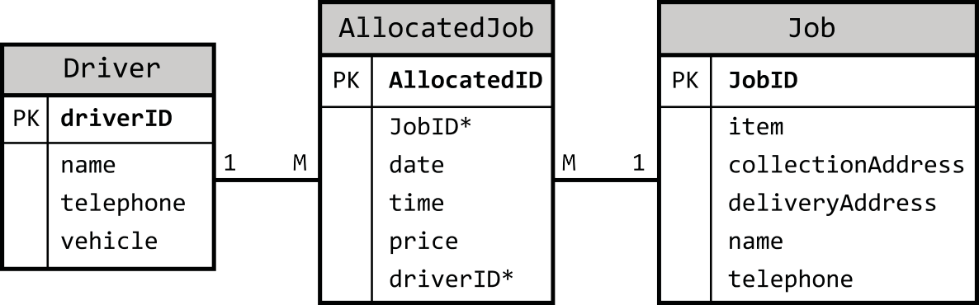
106 TOPIC 5. END OF UNIT TEST
End of unit 3 test
Go online
Use this diagram to answer Questions 1 and 2. A database is designed as shown.
Q1: Which SQL statement will display the JobID of jobs allocated to a driver called 'Colin Shaw'?
a)
1
2
3
4
5
SELECT JobID
FROM Job J, AllocatedJob AJ , Driver D WHERE J. JobID = AJ . D river ID
AND AJ . JobID = D . D river ID
AND J. nam e = 'Colin Shaw ';
b)
1
2
3
4
SELECT JobID FROM Job
WHERE Driver . name = 11 C olin Shaw 11 JOIN driverID = JobID ;
c)
1 2 |  | SELECT JobID FROM Job J, AllocatedJob AJ , Driver D
 | 3 | WHERE | J. JobID = AJ . JobID
 | 4 | AND | AJ . d riverID= D. DriverID
 | 5 | AND | D. nam e = 'Colin Shaw ';
d)
1
2
3
4
5
SELECT JobID
FROM Job J, AllocatedJob AJ , Driver D WHERE J. JobID = AJ . D river ID
AND AJ . JobID = D . D river ID
AND D. nam e = 'Colin Shaw ';
...............................................
© HERIOT-WATT UNIVERSITY

Slide 109
TOPIC 5. END OF UNIT TEST
107
Q2: Which SQL statement will display all the details about Jobs which are allocated to driverID 1921 where the collectionAddress includes the "Aberdeen".
The list should show the driver name, vehicle, date, JobID and collectionAddress. The results should be displayed so that the earliest job is listed first.
a)
1
SELECT D river . name , Driver . vehicle , ' date ' , Job . JobID , collectionAddress
FROM Driver , AllocatedJob , Job
WHERE D river . d riverID= A llocatedJob. driverID AND A llo ca ted Jo b . JobID = Job . JobID
OR Driver . d river ID = 1921
OR collectionAddress LIKE 11A b erd een11 ORDER BY ' date ' ASC ;
2
3
4
5
6
7
b)
1
SELECT D river . name , Driver . vehicle , ' date ' , Job . JobID , collectionAddress
FROM Driver , AllocatedJob , Job
WHERE D river . d riverID= AllocatedJob. d riverID AND AllocatedJob. JobID = Job. JobID
AND D river . d riverID = 1921
AND collectionAddress LIKE 11% Aberdeen%11 ORDER BY ' date ' ASC , ' time ' ASC ;
2
3
4
5
6
7
c)
1
SELECT D river . name , Driver . vehicle , ' date ' , Job . JobID , collectionAddress
FROM Driver , AllocatedJob , Job
WHERE D river . d riverID= AllocatedJob. d riverID AND AllocatedJob. JobID = Job. JobID
AND D river . d riverID LIKE 11%1921% 11
AND collectionAddress LIKE 11% Aberdeen%11 ORDER BY ' date ' ASC , ' time ' ASC ;
2
3
4
5
6
7
d)
1
SELECT Job . name , Driver . vehicle , date , Job . JobID , collectionAddress
FROM Driver , AllocatedJob , Job
WHERE D river . d riverID= AllocatedJob. d riverID AND AllocatedJob. JobID = Job. JobID
AND D river . d riverID = 1921
AND collectionAddress LIKE 11% Aberdeen%11 ORDER BY ' date ' ASC , ' time ' ASC ;
2
3
4
5
6
7
...............................................
© HERIOT-WATT UNIVERSITY

Slide 110
108 TOPIC 5. END OF UNIT TEST
Q3: Define the term "End Users" when considering the development of a system?
End users are the actual users who will operationally make use of the system.
End users are the client who will be paying for the system.
End users are the general public who would be interacting with the system.
End users are the system owners who have an interest in the system development.
...............................................
Q4: Read this scenario and then identify the End User(s).
Paul Jackson operates a skateboard design service. He custom builds skateboards for his customer. He wants a system developed which will allow customers to select the parts, supplied by various manufacturers, for their skateboards, pay for them and the build process online. The system will then produce work jobs for Paul, so that he can build the boards with the requested parts.
Identify who the end user(s) would be.
Customers
Paul Jackson
Manufacturers and Paul Jackson
Customers and Paul Jackson
...............................................
Q5: Define the term Functional Requirements. Functional requirements. . .
are specific actions that the system must perform.
are how the system must work.
define the security of the system.
define the reliability of the system.
...............................................
Q6: In Agile development, the functional requirements are captured in the. . .
system design.
requirements specification.
product backlog.
outline hardware specification.
...............................................
© HERIOT-WATT UNIVERSITY

Slide 111
TOPIC 5. END OF UNIT TEST
109
Q7: How are functional requirements different from non-functional requirements?
Functional and non-functional requirements explain the quality requirements of system. Non-functional requirements state which parts of the system should be measured and the functional requirement detail how each part should be measured.
Functional requirements define what the system must do. Non-functional requirements define how the system should behave.
Functional requirements detail how the modules of code in the system should be linked to each other. Non-functional requirements detail how the documentation will be written.
Functional requirements are defined by the system owner only whereas non-functional requirements can be suggested by anyone associated with the system.
...............................................
Q8: This is an entity-occurrence diagram that shows the links between instances in two entities. What is the relationship between the two entites?
One-to-many
Many-to-many
One-to-one
Indeterminate
...............................................
© HERIOT-WATT UNIVERSITY

Slide 112
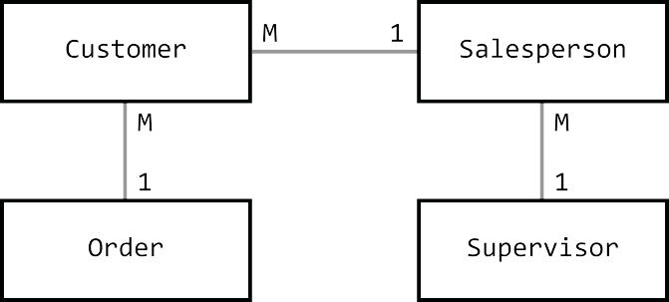
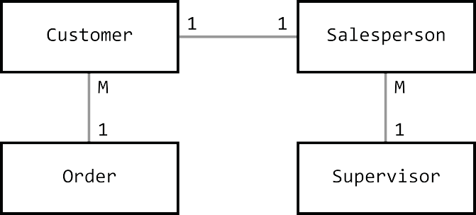
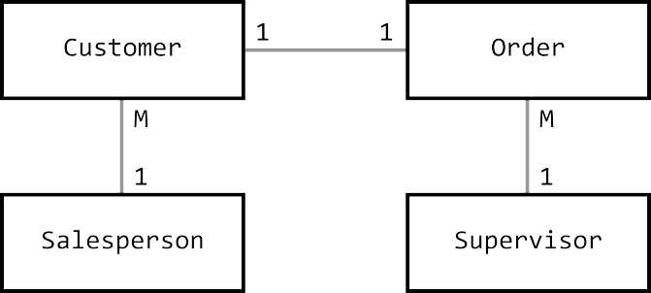
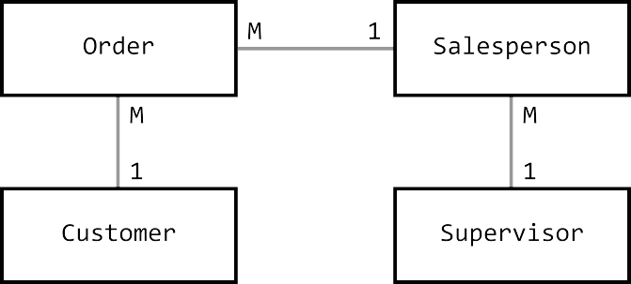
110 TOPIC 5. END OF UNIT TEST
Q9: Examine this data model and then identify the correct Entity Relationship Diagram for this data model.
Table: Customer | Table: Order | Table: Salesperson | Table: Supervisor
cust id | order code | sales id | sup id
cust name | item name | grade | dept
cust address cust tel no | Price cust id* | date employed sup id*
credit limit | sales id*
 | saledate
a)
b)
c)
d)
...............................................
© HERIOT-WATT UNIVERSITY

Slide 113
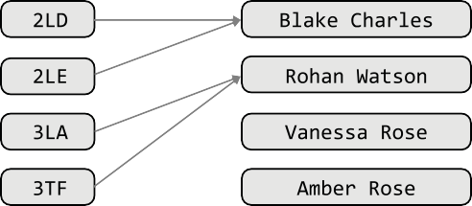

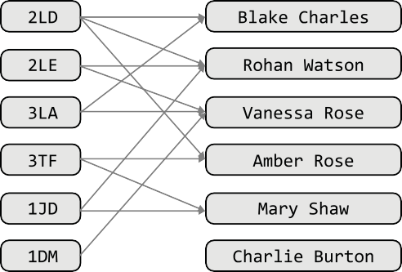
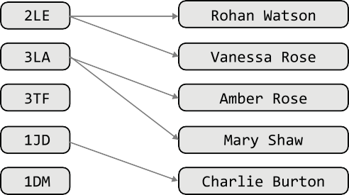
TOPIC 5. END OF UNIT TEST
111
Q10: Senior Pupil Tutors at Someplace Academy attend classes to provide extra support for teachers. Any class in the school may have one, two or more tutors allocated to it and tutors can go to more than one class.
Which Entity Occurrence Diagram is correctly identifies the relationship between Tutors and Classes?
a)
b)
c)
d)
© HERIOT-WATT UNIVERSITY

Slide 114
112 TOPIC 5. END OF UNIT TEST
...............................................
Q11: MIN is a functional of relational database. Identify the four other aggregate functions of database that you should be familiar with.
MOST, MEAN, TOTAL, NUMBEROF
MAX, MEDIAN, SUM, COUNT
MAX, AVG, SUM, COUNT
LEVEL, AVG, TOTAL, NUMBEROF
...............................................
Q12: Which of these statements is the correct definition of a primary key?
An attribute that is the same for all the entities.
The longest attribute within an entity.
The shortest attribute within an entity.
An attribute that has a unique value for each entity.
...............................................
Q13: Which of these statements is the correct definition of a foreign key?
An attribute that is the primary key of another entity set.
The attribute field within an entity.
The most important attribute in an entity.
An attribute in a foreign language.
...............................................
Q14: A compound key is. . .
a combination of a primary and foreign key to link to entity sets.
a combination of more than one attribute to uniquely identify an entity.
an attribute of the entity that is important and will be indexed to ensure fast access within search.
an unique identifier for an entity that consists on a single attribute.
© HERIOT-WATT UNIVERSITY

Slide 115
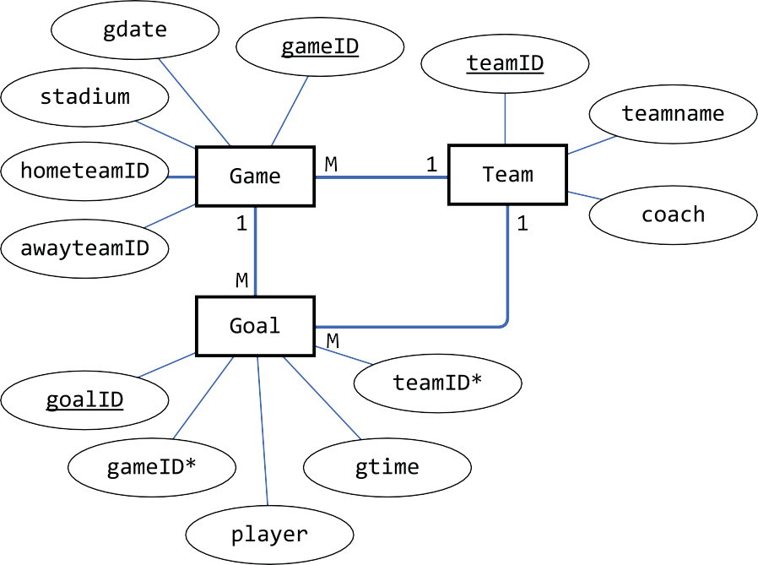
TOPIC 5. END OF UNIT TEST
113
Use this diagram to answer Questions 15, 16, 17 and 18.
Examine this ERD. It records each goal stored in a football game. It also holds the stadium where the game was played and who the home and away teams were. The details of the team; their name and coach, is also held.
Q15: An SQL query is required to show the player, team, coach and gtime for all goals scored in the first 10 minutes of a game. Identify the correct SQL query.
a)
 | 1 | SELECT player , teamname , coach , gtime
 | 2 | FROM goal , game , team
 | 3 | WHERE game . gameID = goal . gameID
 | 4 | AND gam e . h ometeamID = team . teamID
 | 5 | AND gam e . a wayteamID = team . teamID
 | 6 | AND gtime < = 10;
b)
 | 1 | SELECT player , teamname , coach , gtime
 | 2 | FROM goal , game , team
 | 3 | WHERE game . gameID = goal . gameID
 | 4 | AND goal . teamID = team . teamID
 | 5 | AND gtime < = 10;
c)
 | 1 | SELECT player , teamname , coach , gtime
 | 2 | FROM goal , game , team
 | 3 | WHERE game . gameID = goal . gameID
 | 4 | AND gam e . h ometeamID = team . teamID
 | 5 | AND gtime < = 10;
© HERIOT-WATT UNIVERSITY

Slide 116
114 TOPIC 5. END OF UNIT TEST
d)
1
2
3
4
5
SELECT player , teamname , coach , gtime FROM goal , game , team
WHERE game . gameID = goal . gameID
AND gam e . a wayteamID = team . teamID AND gtime < =10;
...............................................
Q16: An SQL query is required to show all the players and the total goals they scored in each stadium. Identify the correct SQL query.
a)
1
2
3
4
SELECT player , stadium , SUM (*) as Goals FROM Game , Goal
WHERE game . gameID = goal . gameID GROUP BY player , stadium;
b)
1
2
3
4
SELECT player , stadium , SUM (*) as Goals FROM Game , Goal
WHERE game . gameID = goal . gameID GROUP BY stadium , player ;
c)
1
2
3
4
SELECT *, COUNT (*) as Goals FROM Game , Goal
WHERE game . gameID = goal . gameID GROUP BY player , stadium;
d)
1
2
3
4
SELECT player , stadium , COUNT (*) as Goals FROM Game , Goal
WHERE game . gameID = goal . gameID GROUP BY player , stadium;
...............................................
© HERIOT-WATT UNIVERSITY

Slide 117
TOPIC 5. END OF UNIT TEST
115
Q17: An SQL query is required to show the gameID and player for all goals scored by the team with a teamID value of "IRL". Identify the correct SQL query.
a)
1
2
3
4
SELECT gameID , player FROM Game , Goal
WHERE game . gameID = goal . gameID AND teamID = 11IR L 11;
b)
 | 1 | SELECT *
 | 2 | FROM Game , Goal
 | 3 | WHERE hometeamID = Team . teamID
 | 4 | AND teamID = 11IR L 11;
c)
1
2
3
4
SELECT gameID , player FROM Game , Goal
WHERE game . gameID = goal . gameID FIND teamID = 11IR L 11;
d)
1
2
3
4
SELECT gameID , player FROM Game , Goal
WHERE game . gameID = goal . gameID AND teamname = 11IR L 11;
...............................................
Q18: An SQL query is required to show the "gdate" of games and name of the teams in which "Fernando Santos" is was the hometeam coach. Identify the correct SQL query.
a)
 | 1 | SELECT gdate , teamname
 | 2 | FROM Game , Team
 | 3 | WHERE G am e . h ometeamID = | Team . teamID
 | 4 | AND coach = 11 F ernando | Santos 11;
b)
 | 1 | SELECT *
 | 2 | FROM Game , Team
 | 3 | WHERE G am e . a wayteamID = | Team . teamID
 | 4 | AND coach = 11 F ernando | Santos 11;
c)
 | 1 | SELECT gdate , teamname
 | 2 | FROM Game , Team
 | 3 | WHERE G am e . h ometeamID = | Team . teamID
4 |  | AND coach LIKE 11% Santos %11;
© HERIOT-WATT UNIVERSITY

Slide 118
116 TOPIC 5. END OF UNIT TEST
d)
 | 1 | SELECT gdate , teamname
 | 2 | FROM Game , Team
 | 3 | WHERE G am e . h ometeamID = Goal . teamID
 | 4 | AND coach = 11F ern a n d o Santos 11;
...............................................
Q19: A query will calculate subtotal for an online order. It will use the columns "quantity" and "itemPrice" from a table called "ShoppingCart". It will also calculate the VAT to be paid as 20% of the amount to pay from this subtotal. Select the correct SQL to perform this calculation.
a)
1
2
SELECT ( q uantity* itemPrice) AS subtotal , subtotal *20/100 AS VAT FROM cart ;
b)
1
2
3
4
5
SELECT subtotal , ( subtotal *20/100) AS VAT FROM (
SELECT ( q uantity* itemPrice) AS subtotal FROM cart
)
as calculatedCart ;
c)
1
2
3
4
5
SELECT ( q uantity* itemPrice) FROM (
SELECT ( subtotal * 20/100) AS VAT FROM cart
)
as calculatedCart ;
d)
1
2
3
SELECT ( q uantity* itemPrice) AS subtotal , ( q uantity* itemPrice) *20/100 AS VAT
FROM cart ;
...............................................
© HERIOT-WATT UNIVERSITY

Slide 119
TOPIC 5. END OF UNIT TEST
117
Q20: A query is run against the two tables shown. competition
competitionID | country | venue | eventDate
1 | UK | Southport | 13/05/2018
2 | Switzerland | Bern | 29/08/2018
3 | Canada | Montreal | 08/09/2018
... | ... | ... | ...
entryticket
competitionID | Team | Placing | PrizeValue
1 | GoGames | Gold | 20
1 | XForceLite | Silver | 15
1 | TrashCans | Bronze | 10
2 | XForceLite | Gold | 30
2 | Question101 | Silver | 10
2 | TrashCans | Bronze | 0
3 | GoGames | Silver | 40
... | ... | ... | ...
The query:
1
2
3
4
SELECT country , SUM ( P rize V a lu e) FROM competition , entryticket
WHERE competition. competitionID = entryticket. competitionID GROUP BY country;
What is the purpose of the GROUP BY line of the SQL statement?
To enforce referential integrity.
To allow aggregation of data using COUNT.
To group results by country so that each country only appears once.
To establish a one-to-many grouped relationship.
...............................................
© HERIOT-WATT UNIVERSITY

Slide 120
118 TOPIC 5. END OF UNIT TEST
Q21: Identify the query which will have produced this table:
Name | Owner | Hull Type | Crew | Max Speed
Lucky Lady | H. Owen | double | 3 | 29
Gallant | S. Scott | double | 5 | 28
Gretel | W. Robertson | double | 4 | 28
Fulmar II | J. Low | single | 3 | 14
Skylark | J. Unwin | single | 2 | 14
Jasmin | H. Owen | triple | 5 | 24
Ocean Flyer | J. Low | triple | 6 | 22
a)
1
SELECT S a ilb o a t. name , O w ner . Owner , Sailboat. ' H ull Type ' , S a ilb o a t. Crew , Sailboat. ' Max speed '
FROM Sailboat , Owner
WHERE Sailboat. O wnerID = O w ner . OwnerID
AND Sailboat. C rew > 2 AND Sailboat. C rew < 7 AND Sailboat. ' Max speed ' > 13
ORDER BY Sailboat. ' H ull Type ' ASC , S a ilb o a t. Crew DESC ;
2
3
4
5
6
b)
1
SELECT S a ilb o a t. name , O w ner . Owner , Sailboat. ' H ull Type ' , S a ilb o a t. Crew , Sailboat. ' Max speed '
FROM Sailboat , Owner
WHERE Sailboat. C rew > 2 AND Sailboat. C rew < 7 AND Sailboat. ' Max speed ' > 13
ORDER BY Sailboat. ' H ull Type ' ASC ;
2
3
4
5
c)
1
SELECT S a ilb o a t. name , O w ner . Owner , Sailboat. ' H ull Type ' , S a ilb o a t. Crew , Sailboat. ' Max speed '
FROM Sailboat , Owner
WHERE Sailboat. O wnerID = O w ner . OwnerID
AND Sailboat. C rew > 2 AND Sailboat. C rew < 7 AND Sailboat. ' Max speed ' > 13
ORDER BY Sailboat. ' H ull Type ' ASC ;
2
3
4
5
6
d)
1
SELECT S a ilb o a t. name , O w ner . Owner , Sailboat. ' H ull Type ' , S a ilb o a t. Crew , MA X ( S ailboat. ' Max speed ')
FROM Sailboat , Owner
WHERE Sailboat. C rew > 2 AND Sailboat. C rew < 7 AND Sailboat. ' Max speed ' > 13
GROUP BY MA X ( S ailboat. ' Max speed ')
ORDER BY Sailboat. ' H ull Type ' ASC ;
2
3
4
5
6
© HERIOT-WATT UNIVERSITY

Slide 121
GLOSSARY
119
Glossary
*AMP
A combination operating system, Apache web sever, MySQL/MariaDB and PHP commonly used to provide web services.
accuracy of output
the output generated by a solution, matches the specification exactly, based on the data available.
Answer table
this is produced when a query runs
Boolean
a value which can only be true or false
Cardinality
the type of relationship between tables in a relational database: 1:1, 1:many or many:many
Cell
the intersection of a column and a row in database table
Data
any information in a form that can be processed by a computer system
Database
a collection of information stored in a structured format that can be quickly searched or sorted
Data dictionary
a detailed list of data structures and relationships in a programming project
Date
a representation of dates as a data type
Domain
the permitted values of an attribute, for example a type of data (text, numeric, Boolean) and/or a range of numbers, dates, times
End user
the person who makes use of a system by interacting with it directly
Entity
something that exists as a particular and discrete form
Entity occurrence diagram
a diagramming tool which can be used to identify the relationships between different entity sets
Entity relationship diagram
(ERD) a data modelling technique that graphically illustrates an information system's entities and the relationships between those entities
© HERIOT-WATT UNIVERSITY

Slide 122
120
GLOSSARY
Entity set
a collection of entities of similar form represented in a database as a table
Field
one piece of information in a record
fitness for purpose
the solution is "good enough to do the task required".
Foreign key
the primary key of a separate table that is included in a table
Functional requirements
a description of what a system must do
Grouping
gathering together the rows of a table or answer table based on a column or columns with the same value or values
Number
any representation of numbers: integers or real numbers
Primary key
an attribute of an entity that can be used to unique identify it. Within a database, a primary key is a column or columns with a unique value for each row of the database table
Product backlog
in Agile development methodologies, a product backlog details the features of the software which are to be developed
Query
performing a complex search or sort on a database
referential integrity
Defines that the relationship between two tables should always be consistent. A foreign key is a primary key value from another table and must have a related value or the database is inconsistent.
Relational database
a database that contains more than one linked table
Relational database management system
(RDBMS) a system for creating and managing relational databases
Relationship
the association between two entity sets - these are either one-to-one, one-to-many or many- to-many
Requirements specification
in interactive development approaches, the requirements specification details what the system is required to do
© HERIOT-WATT UNIVERSITY

Slide 123
GLOSSARY
121
System owner
the organisation or individual who has commissioned a system to be developed or who has ownership of a system already in place
Text
refers to any data stored as strings of characters using ASCII, UNICODE or another text representation
Time
time represented as a data type
Validation
a rule or rules used to ensure that data entered is what was expected
© HERIOT-WATT UNIVERSITY

Slide 124
122
ANSWERS: UNIT 3 TOPIC 1
Answers to questions and activities
Topic 1: Analysis
Activity: End user scenarios (page 3)
Q1: d) The showroom staff.
Q2: a) Both Amir and the holidaymakers.
Q3: c) Visitors to the library
End of Topic 1 test (page 8)
Q4: c) The system will be protected by an authentication system to prevent unauthorised access.
Q5: c) Systems analyst
Q6: b) Functional requirements define what the system must do. Non-functional requirements define how the system should behave.
© HERIOT-WATT UNIVERSITY

Slide 125
ANSWERS: UNIT 3 TOPIC 2
123
Topic 2: Design
Activity: Attribute types and size (page 16)
Q1:
Attribute | Example | Data type
Surname | Toner | Text
First name | Geraldo | Text
Postcode | TD7 0EG | Text
SQA candidate number | 2311447853 | Text
Enrollment fee paid | £27.50 | Number
All documents received | True | Boolean
Enrolment date | 23/03/14 | Date
Course begins at | 19:30 | Time
Qualification credit value | 24 | Number
Activity: Validation (page 17)
Q2: d) Range
Q3: c) Field Length
Q4: a) Presence check
Q5: b) Restricted Choice
Quiz: Introduction (page 27)
Q6: A column must have a unique name.
All the data in a column must be of the same type. The order of columns in the table isn't important.
Q7: A flat database will only contain one table whereas a relational database will contain more than one.
Q8: b) No
© HERIOT-WATT UNIVERSITY

Slide 126
124
ANSWERS: UNIT 3 TOPIC 2
Activity: Many-to-many (2) (page 32)
Q9:
Entity 1 | Entity 2 | Relationship
School | Head Teacher | 1-to-1
Teacher | Course | many-to-many
Classroom | Desk | 1-to-many
School | Swimming pool | 1-to-1
Pupil | Exam | many-to-many
Quiz: Relationships (page 32)
Q10:
An entity is something about which we want to store information.
An attribute is a characteristic of an entity, it is a piece of information about that entity.
3. A relationship defines how two entities are related. one-to-many or many-to-many.
Q11:
Entities can be related as one-to-one,
Activity: Entity Occurrence Diagrams (page 37)
Q12:
Product 1:M OrderLine OrderLine M:1 Order Order M:1 Customer
ProductID
928
921
922
1029
OrderLineID
10282
10283
10284
10285
10286
10287
OrderNo
128
129
130
CustomerID
7619
7900
130
Quiz: Compound keys (page 41)
Q13: competitionID and position
© HERIOT-WATT UNIVERSITY

Slide 127
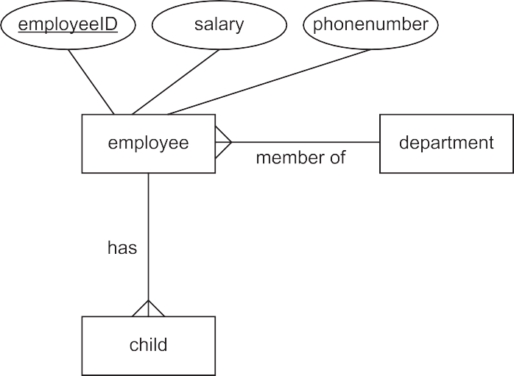


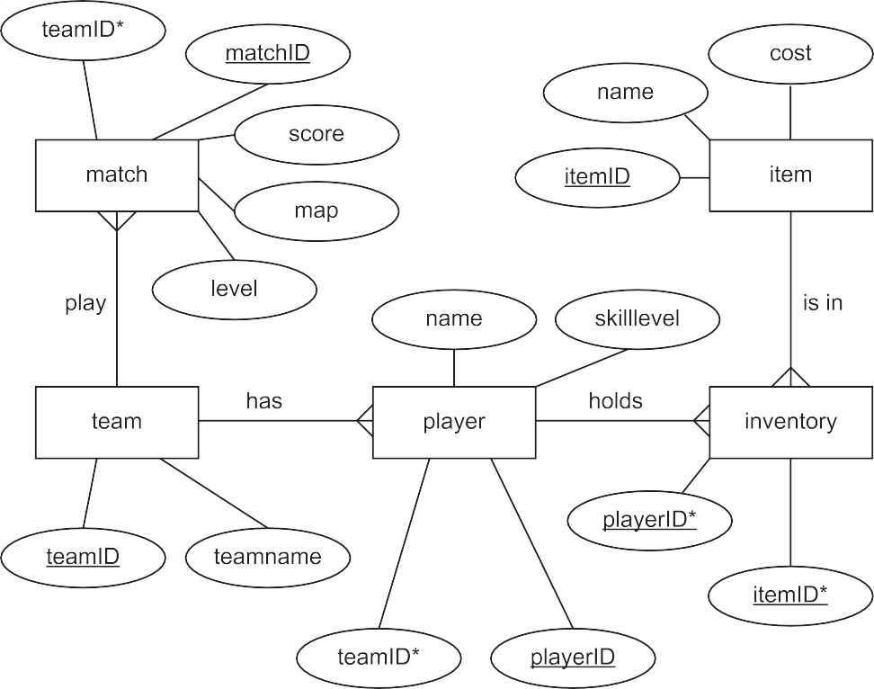
ANSWERS: UNIT 3 TOPIC 2
125
Quiz: Entity relationship diagrams (page 42)
Q14:
Q15:
© HERIOT-WATT UNIVERSITY

Slide 128
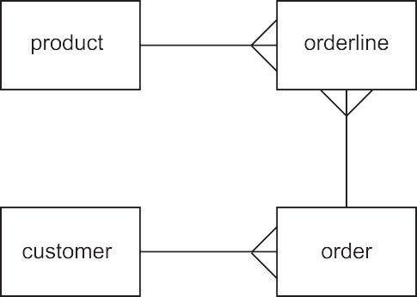
126
ANSWERS: UNIT 3 TOPIC 2
Q16:
End of Topic 2 test (page 52)
Q17: d) An attribute that has a unique value for each entity. Q18: a) An attribute that is the primary key of another entity set. Q19: b) One-to-several
Q20: c) gathers together the rows of a table or answer table based on a column or columns with the same value or values.
Q21: b) a combination of more than one attribute to uniquely identify an entity.
© HERIOT-WATT UNIVERSITY

Slide 129
ANSWERS: UNIT 3 TOPIC 3
127
Topic 3: Implementation
Activity: Using SELECT (1) (page 62)
Q1: SELECT * FROM Post;
Activity: Using SELECT (2) (page 62) Q2: SELECT UserID FROM Post;
Activity: Using SELECT (3) (page 62)
Q3: SELECT UserID, PostContent FROM Post;
Activity: Using SELECT (4) (page 62)
Q4: SELECT * FROM User, Post WHERE User.UserID = Post.UserID;
Activity: Using SELECT (5) (page 63) Q5:
1
2
3
SELECT * FROM User , Post
WHERE User . U serID = Post . UserID AND PostID = 281756;
Activity: Using SELECT (6) (page 63)
Q6:
1
2
SELECT * FROM Post WHERE PostID < 281749;
Activity: Using SELECT (7) (page 64)
Q7:
1
2
SELECT PostID , PostContent FROM Post
WHERE PostID < 281722 OR PostID > 281954;
Activity: Using SELECT (8) (page 64)
Q8:
© HERIOT-WATT UNIVERSITY

Slide 130
128
ANSWERS: UNIT 3 TOPIC 3
1
2
3
SELECT AccountName , PostContent FROM User , Post WHERE User . UserID = Post . U serID
AND ( P ostID = 281821 OR PostID = 281829);
Activity: Using SELECT (9) (page 64)
Q9:
1
2
3
SELECT *
FROM Post
ORDER BY UserID ASC ;
Activity: Using SELECT (10) (page 65)
Q10:
1
2
3
SELECT *
FROM Post
ORDER BY UserID DESC , PostContent ASC ;
Activity: Using SELECT (11) (page 65)
Q11:
1
2
3
4
SELECT *
FROM Post
WHERE PostID > 281952
ORDER BY UserID ASC , PostContent DESC ;
© HERIOT-WATT UNIVERSITY

Slide 131
ANSWERS: UNIT 3 TOPIC 3
129
Activity: Using SELECT (12) (page 65)
Q12:
1
2
3
4
SELECT User . U serID , PostID FROM User , Post
WHERE User . U serID = Post . UserID AND User . UserID > 72656 ORDER BY User . U serID ASC , PostID ASC ;
Alternative answer:
1
2
3
4
SELECT Post . U serID , PostID FROM User , Post
WHERE User . U serID = Post . UserID AND Post . UserID > 72656 ORDER BY User . U serID ASC , PostID ASC ;
Activity: Using INSERT (1) (page 67)
Q13:
1
2
INSERT INTO User
VALUES (72662 , 11 G ood101 11) ;
Activity: Using INSERT (2) (page 67)
Q14:
1
2
INSERT INTO Post
VALUES (72662 , 281958 , 11I so need a Durr Burger Skin !!11) ;
Activity: Using UPDATE (1) (page 69)
Q15:
1
2
3
UPDATE User
SET AccountName = 11R o h a n B ea r11 WHERE AccountName = 11 Q uietRam11;
Activity: Using UPDATE (2) (page 70)
Q16:
1
2
3
UPDATE Post
SET UserID = 72645 WHERE UserID = 72634;
© HERIOT-WATT UNIVERSITY

Slide 132
130
ANSWERS: UNIT 3 TOPIC 3
Activity: Using UPDATE (3) (page 70)
Q17:
1
2
3
UPDATE Post
SET PostContent = 11B est leave it unsolved.11 WHERE PostID = 281758;
Activity: Using DELETE (1) (page 71)
Q18:
1
2
DELETE FROM Post
WHERE PostId = 281954;
Activity: Using DELETE (2) (page 71)
Q19:
1
2
3
4
5
DELETE FROM User
WHERE UserID = 72660;
DELETE FROM Post
WHERE UserID = 72660;
Activity: Using DELETE (3) (page 72)
Q20:
1
2
DELETE FROM Post
WHERE PostID > 281795 AND PostID < 281802;
Activity: Using DELETE (4) (page 72)
Q21:
1
2
DELETE FROM Post
WHERE PostID = 281838 OR PostID = 281841 OR PostID = 281843;
Activity: Using Wildcards (page 75)
Q22:
1
2
SELECT id , title FROM movie
WHERE title LIKE 11 Star Wars %11;
© HERIOT-WATT UNIVERSITY

Slide 133
ANSWERS: UNIT 3 TOPIC 3
131
Q23:
1
2
SELECT id , title FROM movie WHERE title LIKE 11___ 11;
Q24:
1
2
SELECT id , title FROM movie WHERE title LIKE 11% P art__ 11;
Activity: Using MIN (page 80)
Q25:
1
2
SELECT MIN ( gross ) FROM movie
WHERE budget IS NOT NULL AND gross IS NOT NULL ;
Activity: Using MAX (page 80)
Q26:
1
2
3
SELECT title , year FROM movie
WHERE year = (SE LE C T MAX ( year ) from movie );
Activity: Using AVG (page 81)
Q27:
a)
1
2
SELECT AVG ( gross ) FROM movie WHERE gross IS NOT NULL ;
b)
1
2
SELECT AVG ( budget ) FROM movie WHERE year = 1975;
Activity: Using SUM (page 81)
Q28:
1
2
SELECT SUM ( gross ) FROM movie WHERE year = 1999;
© HERIOT-WATT UNIVERSITY

Slide 134
132
ANSWERS: UNIT 3 TOPIC 3
Activity: Using COUNT (page 81)
Q29:
1
2
3
SELECT COUNT (*)
FROM movie
WHERE year > 1974 AND year < 1980;
Activity: Using computed values (1) (page 82)
Q30:
1
2
3
SELECT title , year , gross / budget AS 11 R atio 11 FROM movie
WHERE year = 2001 AND budget IS NOT NULL AND gross IS NOT NULL AND
gross / budget = ( SELECT MAX ( gross / budget ) FROM movie
WHERE year = 2001 AND budget IS NOT NULL AND gross IS NOT NULL
);
4
5
6
7
Activity: Using computed values (2) (page 83)
Q31:
1
2
3
4
SELECT title , budget * 1 5 / 1 0 0 AS 11Tax due 11 FROM movie
WHERE title LIKE 11% Gold %11 AND budget IS NOT NULL AND gross IS NOT NULL ;
Activity: Using GROUP BY (page 85)
Q32:
1
2
3
4
SELECT year , SUM ( budget ) AS 11 Movie Budget 11 FROM movie
WHERE budget IS NOT NULL GROUP BY year ;
Q33:
1
2
3
4
SELECT title , COUNT (*) AS 11 Total Cast 11 FROM movie , casting
WHERE movie . id = casting. movieid AND budget > 180000000 GROUP BY title ;
© HERIOT-WATT UNIVERSITY

Slide 135
ANSWERS: UNIT 3 TOPIC 3
133
Q34:
1
2
3
4
5
6
7
SELECT name , count (*) AS 11C ast 11 FROM actor , casting , movie
WHERE actor . id = casting. actorid AND
casting. movieid = movie . id AND ord =1
GROUP BY actor . id ORDER BY Cast DESC ;
Activity: Using ORDER BY (page 85)
Q35:
1
2
3
4
5
SELECT name , Count (*) as 11 N umberOfMovies 11, year FROM actor , casting , movie
WHERE actor . id = casting. actorid AND movie . id = casting. m ovieid GROUP BY name , year
ORDER by NumberOfMovies DESC , year ASC ;
Q36:
1
2
3
4
5
SELECT title , COUNT (*) AS 11 Total Cast 11 FROM movie , casting
WHERE movie . id = casting. movieid AND budget > 180000000 GROUP BY title
ORDER BY title ASC ;
Q37:
1
2
3
SELECT *
FROM movie
ORDER BY year ASC , budget DESC , gross DESC ;
End of topic 3 test (page 87)
Q38: a) SELECT * FROM branch WHERE city = ILondonI OR city=IGlasgowI;
Q39: a)
1
2
3
4
SELECT staffno , lname FROM staff , branch
WHERE staff . branchno = branch . b ra n ch n o AND branch . street = '13 Main Road ';
Q40: c)
SELECT * FROM branch , propertyForRent
WHERE b ra n ch n o. city = ' Edinburgh '
AND propertyForRent. b ranchno = branch . b ra n ch n o;
© HERIOT-WATT UNIVERSITY

Slide 136
134
ANSWERS: UNIT 3 TOPIC 3
Q41: d)
1
2
SELECT fname , lname , MA X( annualsalary) FROM staff , branch WHERE staff . b ra n ch n o = branch . b ra n ch n o AND city = ' Glasgow ';
Q42: b) SELECT * FROM client WHERE rnaxrent < 800;
Q43: a) SELECT * FROM developer WHERE firstnarne LIKE Ia%I;
Q44: c) SELECT * FROM developer ORDER BY firstnarne DESC; Q45: b) DELETE FROM developer WHERE firstnarne = IPeterI; Q46: c)
type | most expensive
SUV | 73000
Coupe | 75000
Q47: c) To group results by country so that each country only appears once.
© HERIOT-WATT UNIVERSITY

Slide 137
ANSWERS: UNIT 3 TOPIC 4
135
Topic 4: Testing and evaluation
Activity: SQL operations (page 97)
Q1: c)
username | platform
shocker | X-station
peach | S-box
peach | X-station
shocker | PC
destroyer | PC
peach | S-box
destroyer | S-box
Q2: a)
game | username | email | message | MAX(score)
Massive RPG | shocker | paul@gamers.org | I want to play competitively | 821200
SuperJoe | peach | sally@scott.com | I'm part of an eSports team | 625100
Terra 1999 | destroyer | chloe@coders.org | I love games | 299000
Q3: d)
username | realname | password | email | message | terms and conditions
destroyer | Chloe Davidson | shadow99 | chloe@coders.org | I love games | on
peach | Sally McDonald | trustme1 | sally@scott.org | I'm part of an eSports team | on
End of topic 4 test (page 102)
Q4: c) the solution is good enough to meet the required need.
Q5: b)
1
SELECT S a ilb o a t. name , Owner . Owner , Sailboat. ' H ull Type ' , Sailboat. Crew , Sailboat. ' Max speed '
FROM Sailboat , Owner
WHERE Sailboat. O wnerID = Owner . O w n er ID
AND Sailboat. C rew > 2 AND Sailboat. C rew < 7 AND Sailboat. ' Max speed ' > 13
ORDER BY Sailboat. ' H ull Type ' ASC ;
2
3
4
5
6
Q6: a)
© HERIOT-WATT UNIVERSITY

Slide 138
136
ANSWERS: UNIT 3 TOPIC 4
1
2
3
SELECT ' Customer Name ' , SUM ( ' Price of item ') FROM Sales
GROUP BY 'Cu sto m er Name ';
Q7: d) the output generated exactly matches the requirements.
© HERIOT-WATT UNIVERSITY

Slide 139


ANSWERS: UNIT 3 TOPIC 5
137
Topic 5: End of unit test
End of unit 3 test (page 106)
Q1: c)
1
2
3
4
5
SELECT JobID
FROM Job J, AllocatedJob AJ , Driver D WHERE J. JobID = AJ . JobID
AND AJ . d riverID= D. DriverID AND D. nam e = 'Colin Shaw ';
Q2: b)
1
2
3
4
5
6
7
SELECT Driver . name , Driver . vehicle , ' date ' , Job . JobID , collectionAddress FROM Driver , AllocatedJob , Job
WHERE D river . d riverID= AllocatedJob. driverID AND AllocatedJob. JobID = Job . JobID
AND D river . d riverID = 1921
AND collectionAddress LIKE 11% Aberdeen%11 ORDER BY ' date ' ASC , ' time ' ASC ;
Q3: a) End users are the actual users who will operationally make use of the system.
Q4: d) Customers and Paul Jackson
Q5: a) are specific actions that the system must perform.
Q6: c) product backlog.
Q7: b) Functional requirements define what the system must do. Non-functional requirements define how the system should behave.
Q8: c) One-to-one
Q9: d)
Q10: b)
© HERIOT-WATT UNIVERSITY

Slide 140
138
ANSWERS: UNIT 3 TOPIC 5
Q11: c) MAX, AVG, SUM, COUNT
Q12: d) An attribute that has a unique value for each entity.
Q13: a) An attribute that is the primary key of another entity set.
Q14: b) a combination of more than one attribute to uniquely identify an entity.
Q15: b)
1
2
3
4
5
SELECT player , teamname , coach , gtime FROM goal , game , team
WHERE game . gameID = goal . gameID AND goal . teamID = team . teamID
AND gtime < = 10;
Q16: d)
1
2
3
4
SELECT player , stadium , COUNT (*) as Goals FROM Game , Goal
WHERE game . gameID = goal . gameID GROUP BY player , stadium;
Q17: a)
1
2
3
4
SELECT gameID , player FROM Game , Goal
WHERE game . gameID = goal . gameID AND teamID = 11IR L 11;
Q18: a)
1
2
3
4
SELECT gdate , teamname FROM Game , Team
WHERE G am e . hometeamID = Team . teamID AND coach = 11F ern a n d o Santos 11;
© HERIOT-WATT UNIVERSITY

Slide 141
ANSWERS: UNIT 3 TOPIC 5
139
Q19: b)
1
2
3
4
5
SELECT subtotal , ( subtotal * 20/100) AS VAT FROM (
SELECT ( q uantity* itemPrice) AS subtotal FROM cart
)
as calculatedCart ;
Q20: c) To group results by country so that each country only appears once.
Q21: c)
1
SELECT S a ilb o a t. name , Owner . Owner , Sailboat. ' H ull Type ' , Sailboat. Crew , Sailboat. ' Max speed '
FROM Sailboat , Owner
WHERE Sailboat. O wnerID = Owner . O w n er ID
AND Sailboat. C rew > 2 AND Sailboat. C rew < 7 AND Sailboat. ' Max speed ' > 13
ORDER BY Sailboat. ' H ull Type ' ASC ;
2
3
4
5
6
© HERIOT-WATT UNIVERSITY

